Slide 1
Lecture 5 - Coroutines & Reactive Programming

Slide 2

Why Reactive?
Unless you can model your entire system synchronously, .a.. single asynchronous source breaks imperative programming. -- Jake Wharton
Rx library

Slide 3




Why Reactive?
interface UserManager { fun getUser(): User
fun setName(name: String) fun setAge(age: Int)
}
val um: UserManager = UserManagerImpl() logd(um.getUser())
um.setName("John Doe") logd(um.getUser())

Slide 4


Why Reactive?
interface UserManager { fun getUser(): User
fun setName(name: String) fun setAge(age: Int)
}
um.setName("John Doe") logd(um.getUser())

Slide 5

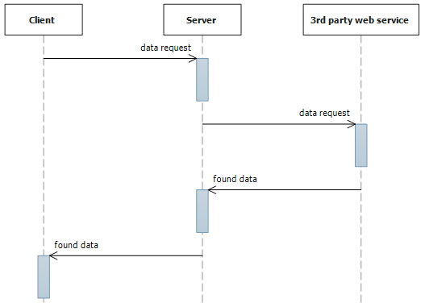

Why Reactive?
val um: UserManagerV2 = UserManagerV2Impl()
logd(um.getUser())
interface UserManagerV2 {
fun getUser(): User
fun setName(name: String, callback: Runnable)
fun setAge(age: Int, callback: Runnable)
}
callback: Runnable)
}
?
? ?
Fail
? ?
?
?
Fail
Fail
Fail

Slide 6

Why Reactive?
interface UserManagerV3 { fun getUser(): User
fun setName(name: String, listener: Listener): void fun setAge(age: Int, listener: Listener): void
interface Listener {
fun success(user: User)
fun failed(error: UserException)
}
}

Slide 7

interface UserManagerV3 { fun getUser(): User
fun setName(name: String, listener: Listener): void fun setAge(age: Int, listener: Listener): void
interface Listener {
fun success(user: User)
fun failed(error: UserException)
}
}
val um: UserManagerV3 = UserManagerV3Impl() logd(um.getUser())
um.setName("John Doe", object : UserManagerV3.Listener { override fun success(user: User) {
logd(user)
}
override fun failed(error: UserException) { loge("Unable to update the user details", error)
}
})

Slide 8
val um: UserManagerV3 = UserManagerV3Impl() logd(um.getUser())
um.setName("John Doe", object : UserManagerV3.Listener { override fun success(user: User) {
logd(user)
}
override fun failed(error: UserException) { loge("Unable to update the user details", error)
}
})
um.setAge(42, object : UserManagerV3.Listener { override fun success(user: User) {
logd(user)
}
override fun failed(error: UserException) { loge("Unable to update the user details", error)
}
})

Slide 9

um.setAge(42, object : UserManagerV3.Listener { override fun success(user: User) {
logd(user)
}
override fun failed(error: UserException) { loge("Unable to update the user details", error)
}
})
um.setName("John Doe", object : UserManagerV3.Listener { override fun success(user: User) {
um.setAge(42, object : UserManagerV3.Listener { override fun success(user: User) {
logd(user)
}
override fun failed(error: UserException) { loge("Unable to update the user details", error)
}
})
}

Slide 10
um.setName("John Doe", object : UserManagerV3.Listener { override fun success(user: User) {
um.setAge(42, object : UserManagerV3.Listener { override fun success(user: User) {
_{logd(user)}
}
override fun failed(error: UserException) { loge("Unable to update the user details", error)
}
_{})}
}
override fun failed(error: UserException) { loge("Unable to update the user details", error)
}
_{})}

Slide 11





Why Reactive?
class UserActivity : AppCompatActivity() {
val um: UserManager = UserManagerImpl()
override fun onCreate(savedInstanceState: Bundle?) {
super.onCreate(savedInstanceState)
setContentView(R.layout.activity_user)
um.setName("John Doe", object : UserManager.Listener {
override fun success(user: User) {
um.setAge(42, object : UserManager.Listener {
override fun success(user: User) {
if (!isDestroyed) {
textView.text = user.name
}
logd(user)
}
override fun failed(error: UserException) {
loge("Unable to update the user details", error)
}
})
}
override fun failed(error: UserException) {
loge("Unable to update the user details", error)
}
})
}
}

Slide 12
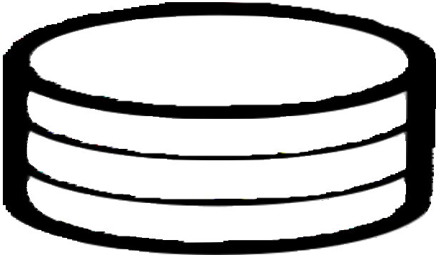




Why Reactive?

Slide 13




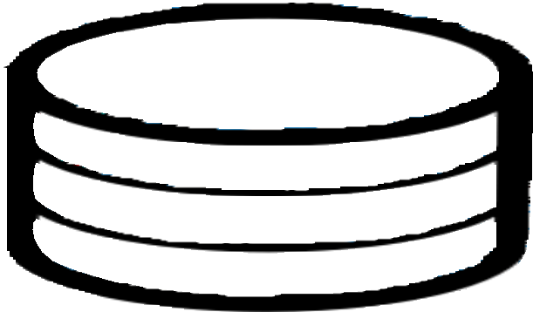



Why Reactive?

Slide 14




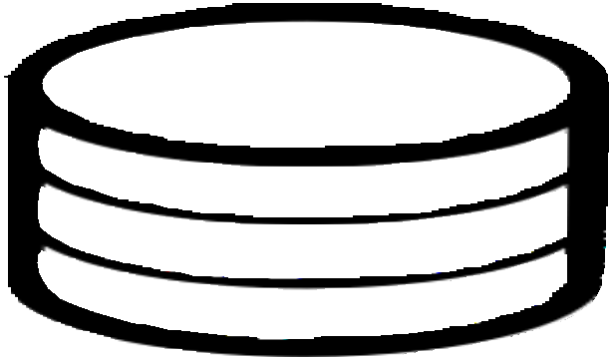







Why Reactive?
UI

Slide 15












Rx{Java|Kotlin|Swift|Dart}
A set of classes for representing sources of data.
A set of classes for listening to data sources.
A set of methods for modifying and composing the data.
http://reactivex.io/

Slide 16
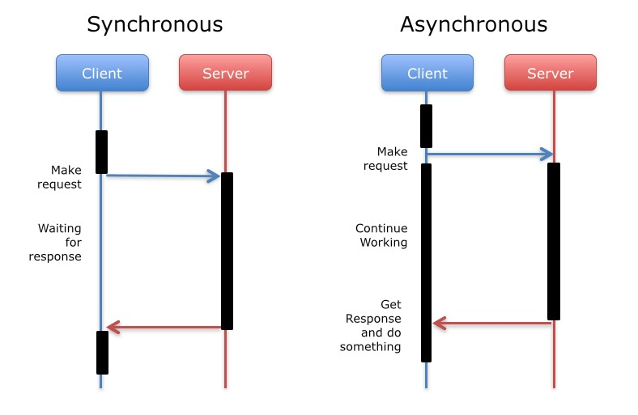
Sources
Synchronous or asynchronous.
Single item, many items, or empty.
Terminates with an error or succeeds to completion.
May never terminate!
Just an implementation of the Observer pattern.

Slide 17
Sources
Observable<T>
  Emits 0 to N items.
  Emits 0 to N items.
  Terminates with complete or error
  Doesn’t have backpressure
Flowable<T>
Emits 0 to N items.
Terminates with complete or error.
Has backpressure

Slide 18
Flowable vs. Observable
Observable<MotionEvent>
interface Observer<T>{ fun onNext(t: T)
fun onComplete()
fun onError(t: Throwable)
fun onSubscribe(d: Disposable)
}
interface Disposable{ fun dispose()
}
Flowable<User>
interface Subscriber<T>{ fun onNext(t: T)
fun onComplete()
fun onError(t: Throwable)
fun onSubscribe(s: Subscription)
}
interface Subscription{ fun cancel()
fun request(r: Long)
}

Slide 19
Sources
interface UserManager {
fun getUser(): Observable<User> fun setName(name: String)
fun setAge(age: Int)
}

Slide 20

Specialized Sources
Encoding subsets of Observable into the type
system:
Single
  Either succeeds with an item or an error.
  No backpressure support.
Completable
Runnable
Either completes or errors. Has no items!
No backpressure support.
Maybe
Optional
Either succeeds with an item, completes with no items, or error.
No backpressure support.

Slide 21
Sources
interface UserManager {
fun getUser(): Observable<User>
fun setName(name: String)): Completable fun setAge(age: Int)): Completable
}

Slide 22
Creating Sources
Flowable.just("Hello")
Flowable.just("Hello", "World")
Observable.just("Hello")
Observable.just("Hello", "World")
Single.just("Hello")
val array = arrayListOf("Hello", "World")
val list = array.toList()
Flowable.fromArray(array)
Flowable.fromIterable(list)
Observable.fromArray(array)
Observable.fromIterable(list)
Observable.fromCallable {
setName()
}

Slide 23
Creating Sources
val url = "https://example.com"
val request = Request.Builder().url(url).build() val client = OkHttpClient()
Observable.fromCallable { client.newCall(request).execute()
}

Slide 24
Create Sources
Observable.create<String> { it.onNext("Hello") it.onComplete()
}
Observable.create(ObservableOnSubscribe<String> { it.onNext("Hello")
it.onComplete()
})
Observable.create(ObservableOnSubscribe<String>( function = fun(it: ObservableEmitter<String>) { it.onNext("Hello")
it.onComplete()
}))

Slide 25
Create Sources
Observable.create<View> {
it.setCancellable { textView.setOnClickListener(null) }
textView.setOnClickListener { v -> it.onNext(v) }
}
val request = Request.Builder().url(url).build()
val client = OkHttpClient()
Observable.create<String> {
val call = client.newCall(request)
it.setCancellable { call.cancel() }
call.enqueue(object : Callback {
override fun onFailure(call: Call, e: IOException) {
it.onError(e)
}
override fun onResponse(call: Call, response: Response) { it.onNext(response.body().toString())
it.onComplete()
}
})
}

Slide 26
Observing Sources
Observable<MotionEvent>
interface Observer<T>{ fun onNext(t: T)
fun onComplete()
fun onError(t: Throwable)
fun onSubscribe(d: Disposable)
}
interface Disposable{ fun dispose()
}
Flowable<User>
interface Subscriber<T>{ fun onNext(t: T)
fun onComplete()
fun onError(t: Throwable)
fun onSubscribe(s: Subscription)
}
interface Subscription{ fun cancel()
fun request(r: Long)
}

Slide 27
Observing Sources
val observable: Observable<String> = Observable.just("Hello")
observable.subscribe(object: DisposableObserver<String>() {
override fun onComplete() {
//...
}
override fun onNext(t: String) {
//...
}
override fun onError(e: Throwable) {
//...
}
})
observable.subscribe(observer)
observer.dispose()

Slide 28












Rx{Java|Kotlin|Swift|Dart}
a set of classes for representing sources of data
a set of classes for listening to data sources
A set of methods for modifying and composing the data

Slide 29
Operators
Manipulate or combine data in some way.
Manipulate threading in some way.
Manipulate emissions in some way.

Slide 30
Operators
val greeting = "Hello"
val yelling = greeting.toUpperCase()
val greeting = Observable.just("Hello“)
val yelling = greeting.map { it.toUpperCase() }

Slide 31
Operators
class UserActivity : AppCompatActivity() { val um: UserManager = UserManagerImpl()
override fun onCreate(savedInstanceState: Bundle?) { super.onCreate(savedInstanceState) setContentView(R.layout.activity_user) um.setName("John Doe", object : UserManager.Listener {
override fun success(user: User) {
um.setAge(42, object : UserManager.Listener { override fun success(user: User) {
runOnUiThread {
if (!isDestroyed) { textView.text = user.name
}
}
}
override fun failed(error: UserException) { loge("Unable to update the user details", error)
}
})
}
//...
})
}
}

Slide 32
Being Reactive
// onCreate
val disposables = CompositeDisposable()
disposables.add(um.getUser()
.observeOn(AndroidSchedulers.mainThread())
.subscribeWith(object: DisposableObserver<User>() {
override fun onNext(user: User) {
textView.text = uset.toString()
}
override fun onError(e: Throwable) {
}
override fun onComplete() {
}
}))
// onDestroy
disposable.dispose()

Slide 33
Dependencies
allprojects { repositories {
maven { url "https://oss.jfrog.org/libs-snapshot" }
}
}
dependencies {
implementation 'io.reactivex.rxjava3:rxandroid:3.0.0'
// Because RxAndroid releases are few and far between, it is recommended you also
// explicitly depend on RxJava's latest version for bug fixes and new features.
// (see https://github.com/ReactiveX/RxJava/releases for latest 3.x.x version) implementation ‘io.reactivex.rxjava3:rxjava:3.1.5’
}

Slide 34
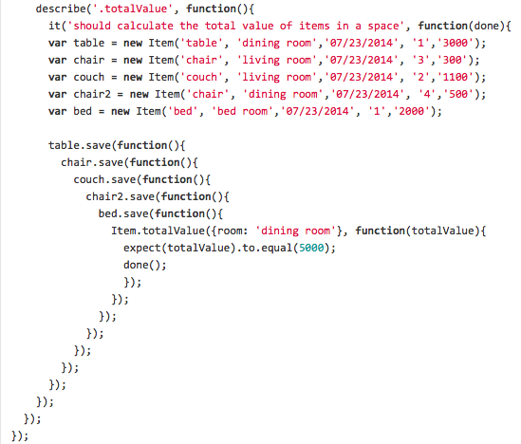
Options
Callbacks
Futures
Promises
Rx
Coroutines – lightweight execution threads
https://kotlinlang.org/docs/reference/coroutines-overview.html

Slide 35

Coroutines
fun requestToken(): Token {
// make a token request and waits
return token
}
fun createPost(token: Token, item: Item): Post {
logd("Posting an $item using $token")
// sends the item to the server and waits
return post
}
fun processPost(post: Post) {
// processing the post
logd("Processing a $post")
}
fun postItem(item: Item) {
val token = requestToken()
val post = createPost(token, item)
processPost(post)
}

Slide 36

Coroutines
suspend fun requestToken(): Token {
// make a token request and suspends return token
}
suspend fun createPost(token: Token, item: Item): Post { logd("Posting an $item using $token")
//sends the item to the server and waits return post
}
fun processPost(post: Post) {
// processing the post logd("Processing a $post")
}
suspend fun postItem(item: Item) {
val token = requestToken()
val post = createPost(token, item) processPost(post)
}

Slide 37

Bonuses
Regular loops:
for ((token, item) in list) {
createPost(token, item)
}
Regular exception handling:
try {
createPost(token, item)
} catch(e: BadTokenException) { …. }
Regular higher-order function:
file.readLines().forEach { line ->
createPost(token, line.toItem())
}

Slide 38
Builders
suspend fun requestToken(): Token {
// make a token request and suspends return token
}
suspend fun createPost(token: Token, item: Item): Post { logd("Posting an $item using $token")
//sends the item to the server and waits return post
}
fun processPost(post: Post) {
// processing the post logd("Processing a $post")
}
suspend fun postItem(item: Item) {
val token = requestToken()
val post = createPost(token, item)
processPost()
}

Slide 39
Builders
suspend fun requestToken(): Token {
// make a token request and suspends return token
}
suspend fun createPost(token: Token, item: Item): Post { logd("Posting an $item using $token")
//sends the item to the server and waits return post
}
fun processPost(post: Post) {
// processing the post logd("Processing a $post")
}
fun postItem(item: Item) { viewModelScope.launch {
val token = requestToken()
val post = createPost(token, item) processPost(post)
}
}

Slide 40
Builders – CoroutineScope.launch actual implementation
public fun CoroutineScope.launch(
context: CoroutineContext = EmptyCoroutineContext,
start: CoroutineStart = CoroutineStart.DEFAULT,
block: suspend CoroutineScope.() -> Unit
): Job {
val newContext = newCoroutineContext(context)
val coroutine = if (start.isLazy)
LazyStandaloneCoroutine(newContext, block) else StandaloneCoroutine(newContext, active = true)
coroutine.start(start, coroutine, block)
return coroutine
}

Slide 41
Dependencies
dependencies {
implementation “org.jetbrains.kotlinx:kotlinx-coroutines-android:<version>”
}

Slide 42
Usage
class MyViewModel : ViewModel() {
private val _result = MutableLiveData<String>() val result: LiveData<String> = _result
init { viewModelScope.launch {
val computationalResult = doComputation()
_result.value = computationalResult
}
}
}
implementation “androidx.lifecycle:lifecycle-viewmodel-ktx:<version>”

Slide 43
Usage
class MyNewViewModel : ViewModel() { val result = liveData { emit(doComputation())
}
}
implementation “androidx.lifecycle:lifecycle-livedata-ktx:<version>”

Slide 44
Flow
fun foo(): Flow<Int> = flow { // flow builder for (i in 1..3) {
delay(100) // pretend we are doing something useful here emit(i) // emit next value
}
}
fun main() = runBlocking<Unit> {
// Launch a concurrent coroutine to check if the main thread is blocked launch {
for (k in 1..3) {
println("I'm not blocked $k") delay(100)
}
}
// Collect the flow
foo().collect { value -> println(value) }
}
Output:
I'm | not | blocked | 1
1
I'm | not | blocked | 2
2
I'm | not | blocked | 3
3

Slide 45

Flow Cancellation
fun fooCancellation(): Flow<Int> = flow {
for (i in 1..3) {
delay(100)
println("Emitting $i") emit(i)
}
}
Output:
Emitting 1
1
Emitting 2
2
Done
fun main() = runBlocking<Unit> {
withTimeoutOrNull(250) { // Timeout after 250ms
fooCancellation().collect { value -> println(value) }
}
println("Done")
}

Slide 46
Flow Operators
suspend fun performRequest(request: Int): String { delay(1000) // imitate long-running asynchronous work return "response $request"
}
Output:
fun main() = runBlocking<Unit> { (1..3).asFlow() // a flow of requests
.map { request -> performRequest(request) }
.collect { response -> println(response) }
}
response 1
response 2
response 3

Slide 47
Transform Operator
suspend fun performRequest(request: Int): String { delay(1000) // imitate long-running asynchronous work return "response $request"
}
(1..3).asFlow() // a flow of requests
.transform { request -> emit("Making request $request") emit(performRequest(request))
}
.collect { response -> println(response) }
Output:
Making request 1
response 1
Making request 2
response 2
Making request 3
response 3

Slide 48
Size-limiting Operators
fun numbers(): Flow<Int> = flow { try {
emit(1) emit(2)
println("This line will not execute") emit(3)
} finally {
println("Finally in numbers")
}
Output:
1
2
Finally in numbers
}
@ExperimentalCoroutinesApi
fun main() = runBlocking<Unit> { numbers()
.take(2) // take only the first two
.collect { value -> println(value) }
}

Slide 49
Collecting from a flow
class NewsRepository(
private val newsRemoteDataSource: NewsRemoteDataSource, private val userData: UserData
) {
/**
Returns the favorite latest news applying transformations on the flow.
These operations are lazy and don't trigger the flow. They just transform
the current value emitted by the flow at that point in time.
*/
val favoriteLatestNews: Flow<List<ArticleHeadline>> = newsRemoteDataSource.latestNews
// Intermediate operation to filter the list of favorite topics
.map { news -> news.filter { userData.isFavoriteTopic(it) } }
// Intermediate operation to save the latest news in the cache
.onEach { news -> saveInCache(news) }
}

Slide 50
Collecting from a flow
class LatestNewsViewModel(
private val newsRepository: NewsRepository
) : ViewModel() { init {
viewModelScope.launch {
// Trigger the flow and consume its elements using collect newsRepository.favoriteLatestNews.collect { favoriteNews ->
// Update View with the latest favorite news
}
}
}
}

Slide 51
Collecting Flows
userMessages.collect { messages -> listAdapter.submitList(messages)
}

Slide 52
Collecting Flows
userMessages.collect { messages -> listAdapter.submitList(messages)
}

Slide 53
Collect Flows from UI
Collect items when needed
Lifecycle-aware alternatives
androidx.lifecycle:lifecycle-livedata-ktx Flow<T>.asLiveData(): LiveData
androidx.lifecycle:lifecycle-runtime-ktx
Lifecycle. repeatOnLifecycle(state) Flow<T>. flowWithLifecycle (lifecycle, state)

Slide 54
Collect Flows from UI
// import androidx. lifecycle.asLiveData
class MessagesViewModel(repository: MessagesRepository) : ViewModel() { val userMessages = repository userMessages.asLiveData ()
•••
}

Slide 55
Collect Flows from UI
// import androidx. lifecycle. repeatOnLifecycle class MessagesActivity : AppCompatActivity() {
override fun onCreate(savedInstanceState: Bundle?) {
...
lifecycleScope. launch { repeatOnLifecycle(Lifecycle.State.STARTED){
viewModel.userMessages.collect { message ->
listAdapter.submitList(message)
}
}
}
}
}
}

