Slide 1
Course 2 – layouts and resources

Slide 2
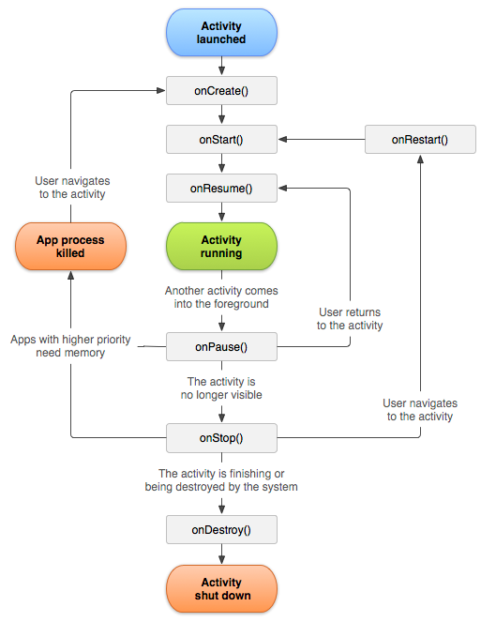
Lifecycle
https://developer.android.com/guide/components/activities/activity-lifecycle

Slide 3
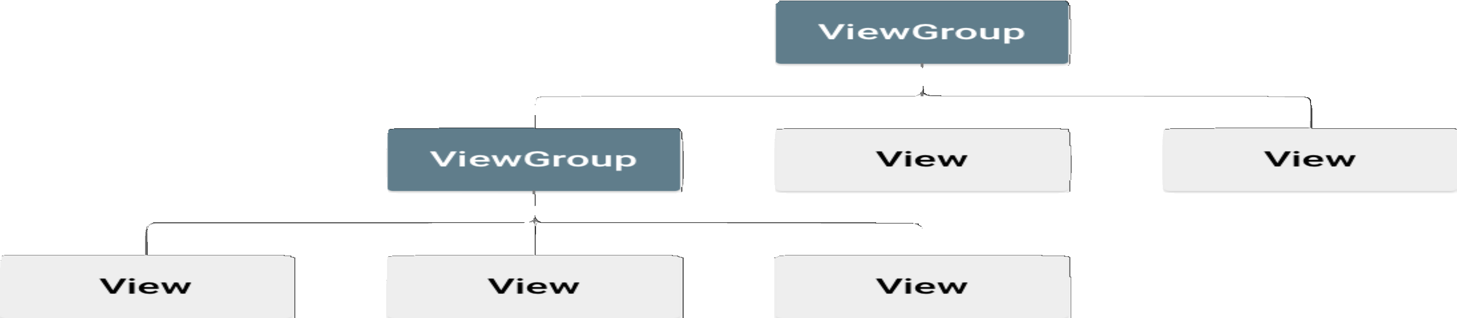
Layouts
https://developer.android.com/guide/topics/ui/declaring-layout

Slide 4
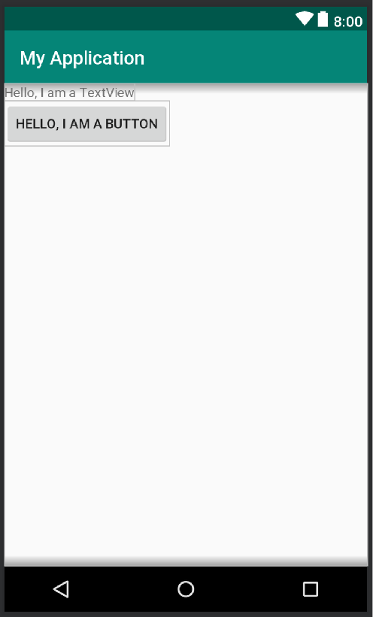
XML
<?xml version="1.0" encoding="utf-8"?>
<LinearLayout xmlns:android="http:// schemas.android.com/apk/res/android"
android:layout_width="match_parent" android:layout_height="match_parent" android:orientation="vertical">
<TextView android:id="@+id/text"
android:layout_width="wrap_content" android:layout_height="wrap_content" android:text="Hello, I am a TextView"/>
<Button android:id="@+id/button" android:layout_width="wrap_content" android:layout_height="wrap_content" android:text="Hello, I am a Button"/>
</LinearLayout>
fun onCreate(savedInstanceState: Bundle) { super.onCreate(savedInstanceState) setContentView(R.layout.main_layout)
}

Slide 5
Accessing Assets
<?xml version="1.0" encoding="utf-8"?>
<LinearLayout xmlns:android="http:// schemas.android.com/apk/res/android"
android:layout_width="match_parent" android:layout_height="match_parent" android:orientation="vertical">
<TextView android:id="@+id/text"
android:layout_width="wrap_content" android:layout_height="wrap_content" android:text="Hello, I am a TextView"/>
<Button android:id="@+id/button" android:layout_width="wrap_content" android:layout_height="wrap_content" android:text="Hello, I am a Button"/>
</LinearLayout>
fun onCreate(savedInstanceState: Bundle) { super.onCreate(savedInstanceState) setContentView(R.layout.main_layout)
} val myButton: Button = findViewById(R.id.button)
}

Slide 6
Add Event Handler
...
<Button android:id="@+id/button" android:layout_width="wrap_content" android:layout_height="wrap_content" android:text="Hello, I am a Button"
/>
...
android:onClick="sendMessage"
fun onCreate(savedInstanceState: Bundle) { super.onCreate(savedInstanceState) setContentView(R.layout.main_layout)
val myButton: Button = findViewById(R.id.button)
}
fun sendMessage(view: View) { logd("Ready!")
}

Slide 7
Using Android KTX
import kotlinx.android.synthetic.main.activity_main.*
...
<Button android:id="@+id/button" android:layout_width="wrap_content" android:layout_height="wrap_content" android:text="Hello, I am a Button"
android:onClick="sendMessage"
/>
...
fun onCreate(savedInstanceState: Bundle) { super.onCreate(savedInstanceState) setContentView(R.layout.main_layout)
val myButton : Button = findViewById(R.id.button)
myButton.setOnClickListener {
text.text = "From editText: {editText.text.toString()}"
myButton.text = “Update”
}
fun sendMessage(view: View) {
logd(“Ready!”);
}
https://developer.android.com/kotlin/ktx

Slide 8
Using ViewBinding
plugins { kotlin("android.extensions")
}
android {
...
buildFeatures { viewBinding = true
}
}
private lateinit var binding: MainActivityBinding override fun onCreate(savedInstanceState: Bundle?) {
super.onCreate(savedInstanceState)
binding = MainActivityBinding.inflate(layoutInflater) val view = binding.root
setContentView(view)
}

Slide 9
Using ViewBinding
private lateinit var binding: MainActivityBinding override fun onCreate(savedInstanceState: Bundle?) {
super.onCreate(savedInstanceState)
binding = MainActivityBinding.inflate(layoutInflater) val view = binding.root
setContentView(view)
}
binding.name.text = “Hello, I am a TextView” binding.button.setOnClickListener { viewModel.userClicked() }
https://developer.android.com/topic/libraries/view-binding

Slide 10

Supporting different screen sizes
Flexible layouts
Alternative layouts
Stretchable images
Alternative bitmaps
Vector graphics
https://developer.android.com/guide/practices/screens_support

Slide 11
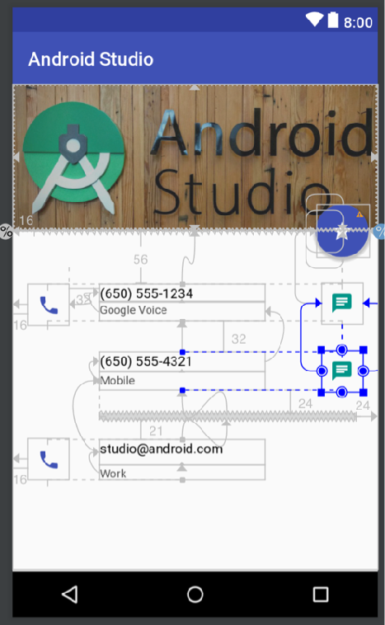
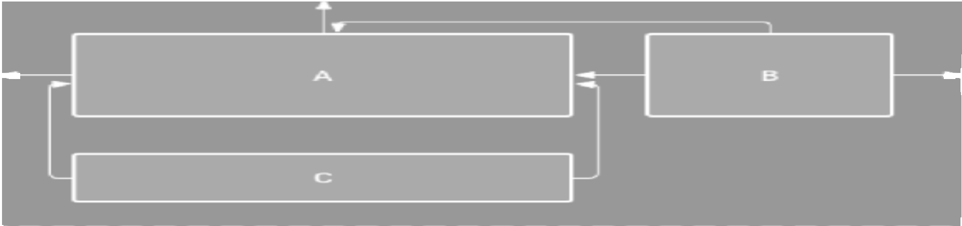
Flexible Layouts
ConstraintLayout
In module-level gradle.build:
repositories {
google()
}
dependencies { implementation
‘com.android.support.constraint:constraint-layout:2.1.4’
}
https://developer.android.com/training/constraint-layout/

Slide 12
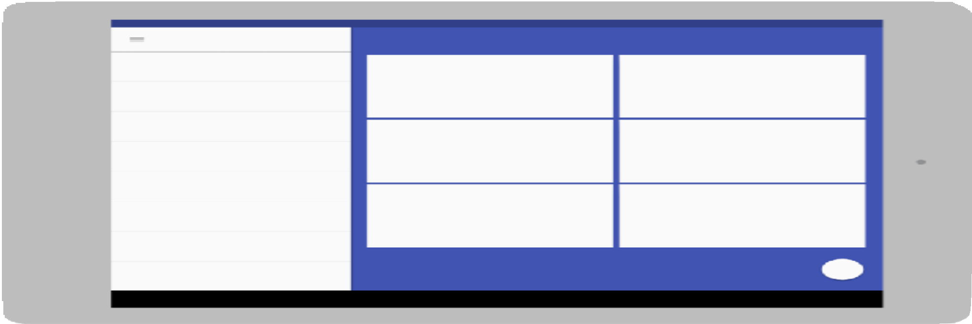

Alternative layouts
res/layout/main_activity.xml | # | Default layout
res/layout-land/main_activity.xml | # | When in landscape |  |  |  | mode
res/layout-sw600dp/main_activity.xml | # | For | 7” | tablets
res/layout-sw600dp-land/main_activity.xml | # | For | 7” | tablets | in | landscape
https://developer.android.com/training/multiscreen/screensizes#alternative-layouts

Slide 13
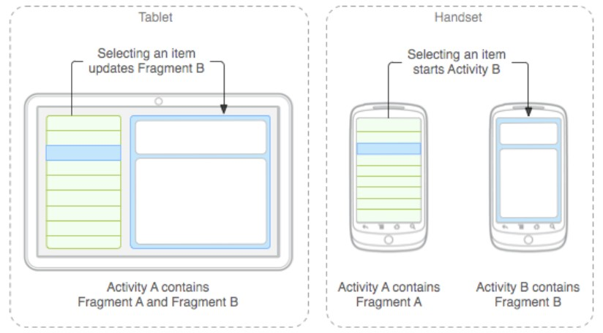
Building a Dynamic UI with Fragments
https://developer.android.com/guide/components/fragments

Slide 14
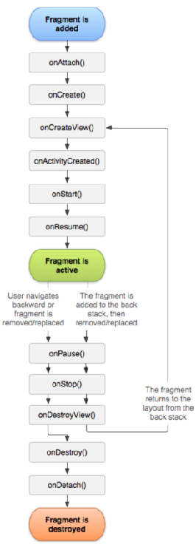
Creating a Fragment
New callbacks
  onAttach
  onCreateView
  onActivityCreated
  onDestroyView
  onDetach
https://developer.android.com/reference/android/support/v4/app/Fragment

Slide 15
Creating a Fragment
class ArticleListFragment : Fragment() {
override fun onCreateView(
inflater: LayoutInflater,
container: ViewGroup?,
savedInstanceState: Bundle?
): View {
// Inflate the layout for this fragment
return inflater.inflate(R.layout.example_fragment,
} container, false)
}
<?xml version=“1.0” xmlns:android="http://schemas.android.com/apk/res/android"
android:orientation=“horizontal”
android:layout_width="match_parent">
android:layout_height="match_parent">
<fragment android:name="com.example.news.ArticleListFragment" android:id="@+id/list"
android:layout_weight="1" android:layout_width="0dp" android:layout_height="match_parent" />
<fragment android:name="com.example.news.ArticleReaderFragment" android:id="@+id/viewer"
android:layout_weight="2" android:layout_width="0dp" android:layout_height="match_parent" />
</LinearLayout>
https://developer.android.com/reference/android/support/v4/app/Fragment

Slide 16
Creating a Fragment
class ArticleListFragment : Fragment() {
override fun onCreateView(
inflater: LayoutInflater, container: ViewGroup?, savedInstanceState: Bundle?
): View {
// Inflate the layout for this fragment
return inflater.inflate(R.layout.example_fragment, container,
}
Or, programmatically add the fragment to an existing ViewGroup
false)
}
val fragmentManager = supportFragmentManager
val fragmentTransaction = fragmentManager.beginTransaction()
val fragment = ArticleListFragment() fragmentTransaction.add(R.id.fragment_container, fragment) fragmentTransaction.commit()
https://developer.android.com/reference/android/support/v4/app/Fragment

Slide 17


Density-independent pixels

Slide 18
Density-independent pixels
<Button android:layout_width="wrap_content" android:layout_height="wrap_content" android:text="@string/clickme" android:layout_marginTop="20dp" />
<TextView android:layout_width="match_parent" android:layout_height="wrap_content" android:textSize="20sp" />

Slide 19


dp units to pixel units
medium-density screen "baseline" density
px = dp * (dpi / 160)
Actual device pixels

Slide 20

Progress Indicators
<ProgressBar
android:id="@+id/indicator"
android:layout_width="wrap_content“
android:layout_height="wrap_content“
android:visibility="gone"
/>
//before starting the action
indicator.visibility = = View.VISIBLE
indicator.visibility = = View.GONE
https://developer.android.com/reference/android/widget/ProgressBar

Slide 21
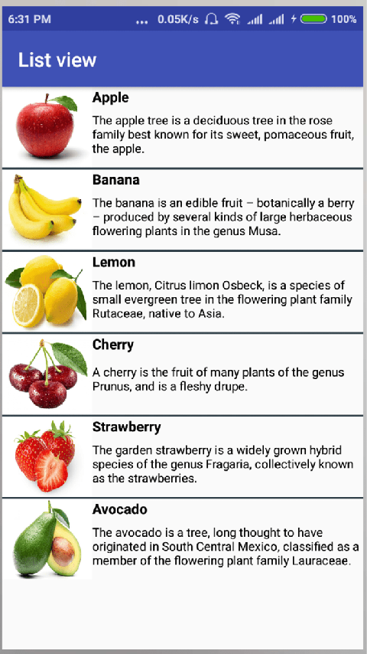
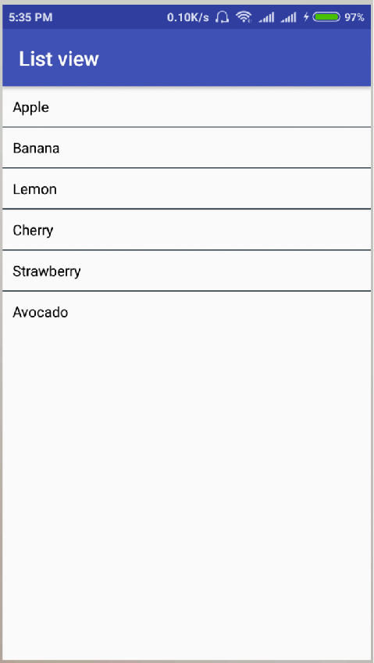
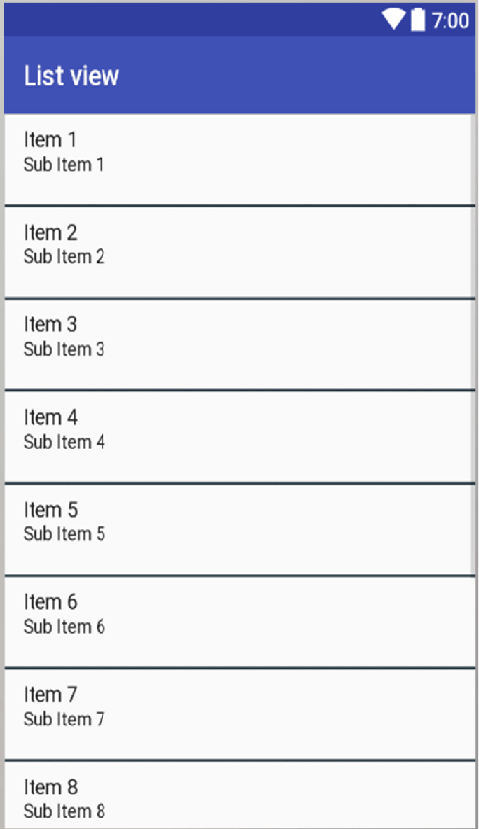
Lists
ListView
RecyclerView

Slide 22
ListView
<?xml version="1.0" encoding="utf-8"?>
<LinearLayout
xmlns:android="http://schemas.android.com/apk/res/android" android:orientation="vertical" android:layout_width="match_parent" android:layout_height="match_parent" android:paddingLeft="8dp"
android:paddingRight="8dp">
<ListView android:id="@android:id/list" android:layout_width="match_parent" android:layout_height="match_parent"/>
</LinearLayout>
<?xml version="1.0" encoding="utf-8"?>
<LinearLayout xmlns:android="http://schemas.android.com/apk/res/android"
android:layout_width="match_parent" android:layout_height="wrap_content" android:orientation="vertical">
<TextView android:id="@+id/text" android:textSize="16sp" android:textStyle="bold" android:layout_width="match_parent" android:layout_height="wrap_content"/>
<TextView android:id="@+id/subText"
...
</LinearLayout>

Slide 23

ListView
<?xml version="1.0" encoding="utf-8"?>
<LinearLayout
xmlns:android="..." android:orientation="vertical" android:layout_width="match_parent" android:layout_height="match_parent" android:paddingLeft="8dp" android:paddingRight="8dp">
<ListView android:id="@android:id/myList" android:layout_width="match_parent" android:layout_height="match_parent"/>
</LinearLayout>
val arrayAdapter = ArrayAdapter<String>(this, android.R.layout.simple_list_item_1, arrayList)
myList.adapter = arrayAdapter
https://developer.android.com/guide/topics/ui/layout/listview

Slide 24
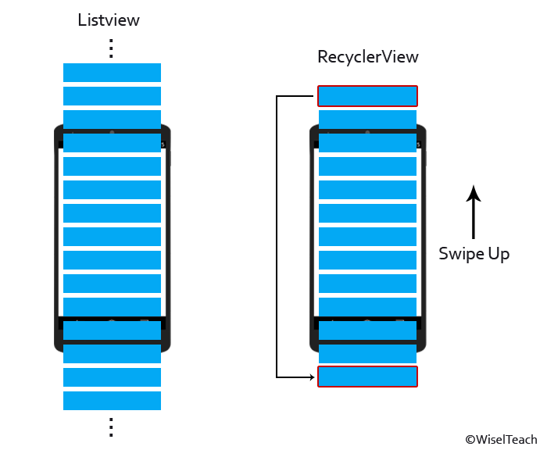
RecyclerView
ListView
RecyclerView

Slide 25

RecyclerView
<?xml version="1.0" encoding="utf-8"?>
<!-- A RecyclerView with some commonly used attributes -->
<android.support.v7.widget.RecyclerView android:id="@+id/my_recycler_view" android:scrollbars="vertical" android:layout_width="match_parent" android:layout_height="match_parent"/>
class MyActivity : Activity() {
private private private
lateinit lateinit lateinit
var recyclerView: RecyclerView
var viewAdapter: RecyclerView.Adapter<*> var viewManager: RecyclerView.LayoutManager
override fun onCreate(savedInstanceState: Bundle?) { super.onCreate(savedInstanceState) setContentView(R.layout.my_activity)
viewManager = LinearLayoutManager(this) viewAdapter = MyAdapter(myDataset)
recyclerView = findViewById<RecyclerView>(R.id.my_recycler_view).apply { setHasFixedSize(true)
layoutManager = viewManager
adapter = viewAdapter
}
}
// ...
}
https://developer.android.com/guide/topics/ui/layout/recyclerview

Slide 26
RecyclerView.Adapter
class MyAdapter(private val myDataset: Array<String>) : RecyclerView.Adapter<MyAdapter.MyViewHolder>() {
class MyViewHolder(val textView: TextView) : RecyclerView.ViewHolder(textView) override fun onCreateViewHolder(parent: ViewGroup,
viewType: Int): MyAdapter.MyViewHolder { val textView = LayoutInflater.from(parent.context)
.inflate(R.layout.my_text_view, parent, false) as TextView
...
return MyViewHolder(textView)
}
// Replace the contents of a view (invoked by the layout manager)
override
// -
// -
fun onBindViewHolder(holder: MyViewHolder, position: Int) { get element from your dataset at this position
replace the contents of the view with that element
holder.textView.text = myDataset[position]
}
override fun getItemCount() = myDataset.size
}
https://developer.android.com/guide/topics/ui/layout/recyclerview

Slide 27
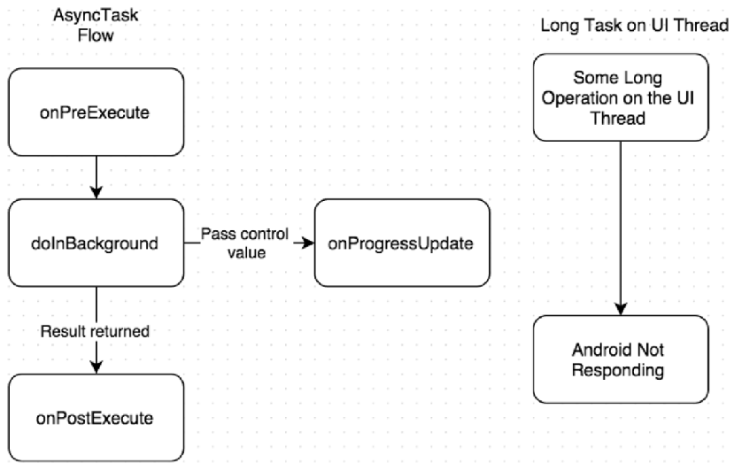
AsyncTask
Deprecated
BackgroundThread
class SomeTask():
AsyncTask<Void, Int, S override fun doInBackground(
vararg params: Void?): String? {
// ...
}
tring>() {
override fun onPreExecute() { super.onPreExecute()
// ...
}
override fun onPostExecute( result: String?) {
super.onPostExecute(result)
// ...
}
override fun onProgressUpdate( vararg values: Int){
super.onProgressUpdate(result)
// ...
}
UiThread
}
https://developer.android.com/reference/android/os/AsyncTask

Slide 28

Anko AsyncTask Alternative
Backgro
undThread
doAsync {
//Execute all the long running
// tasks here
val s: String = makeNetworkCall() uiThread {
//Update the UI thread here alert("Downloaded data is $s",
"Hi I'm an alert") { yesButton { toast("Yay !") } noButton { toast(":( !") }
}.show()
}
}
UiThread
https://github.com/Kotlin/anko/wiki/Anko-Coroutines

Slide 29

Jetpack Compose
https://developer.android.com/jetpack/compose

Slide 30


Compose Layout Basics
Compose transforms state into UI elements, via:
•Composition of elements
•Layout of elements
•Drawing of elements

Slide 31
Goals
•High performance
•Ability to easily write custom layouts

Slide 32
Basics
@Composable fun ArtistCard() {
Text("Alfred Sisley") Text("3 minutes ago")
}

Slide 33

Basics
@Composable fun ArtistCard() {
Column {
Text("Alfred Sisley") Text("3 minutes ago")
}
}

Slide 34

Basics
@Composable
fun ArtistCard(artist: Artist) {
Row(verticalAlignment = Alignment.CenterVertically) { Image(/*...*/)
Column {
Text(artist.name) Text(artist.lastSeenOnline)
}
}
}

Slide 35
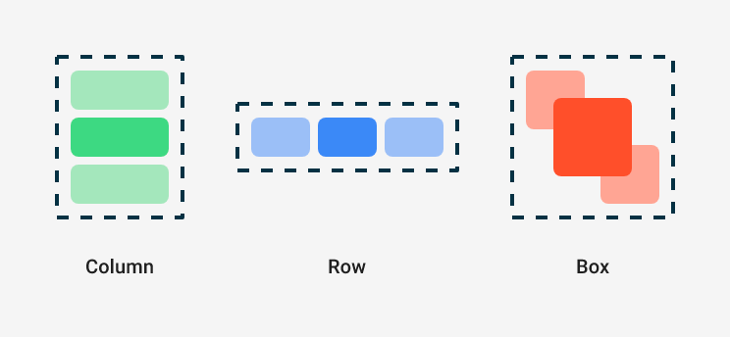
Basics

Slide 36
LazyLists
import androidx.compose.foundation.lazy.items
@Composable
fun MessageList(messages: List<Message>) { LazyColumn {
items(messages) { message ->
MessageRow(message)
}
}
}
https://developer.android.com/jetpack/compose/tutorial

Slide 37
Constraint Layout
@Composable
fun ConstraintLayoutContent() { ConstraintLayout {
// Create references for the composables to constrain
val (button, text) = createRefs() Button(
onClick = { /* Do something */ },
// Assign reference "button" to the Button composable
// and constrain it to the top of the ConstraintLayout modifier = Modifier.constrainAs(button) {
top.linkTo(parent.top, margin = 16.dp)
}
) {
Text("Button")
}
// Assign reference "text" to the Text composable
// and constrain it to the bottom of the Button composable
Text(“Text”, Modifier.constrainAs(text))
}

Slide 38

Adaptive Layouts

Slide 39
Adaptive Layouts
enum class WindowSizeClass { Compact, Medium, Expanded }
@Composable
fun MyApp(windowSizeClass: WindowSizeClass) {
// Perform logic on the size class to decide whether to show
// the top app bar.
val showTopAppBar = windowSizeClass != WindowSizeClass.Compact
// MyScreen knows nothing about window sizes, and performs logic
// based on a Boolean flag. MyScreen(
showTopAppBar = showTopAppBar,
/* ... */
)
}

Slide 40
Flexible Layouts
@Composable fun AdaptivePane(
showOnePane: Boolean,
/* ... */
) {
if (showOnePane) { OnePane(/* ... */)
} else {
TwoPane(/* ... */)
}
}

Slide 41
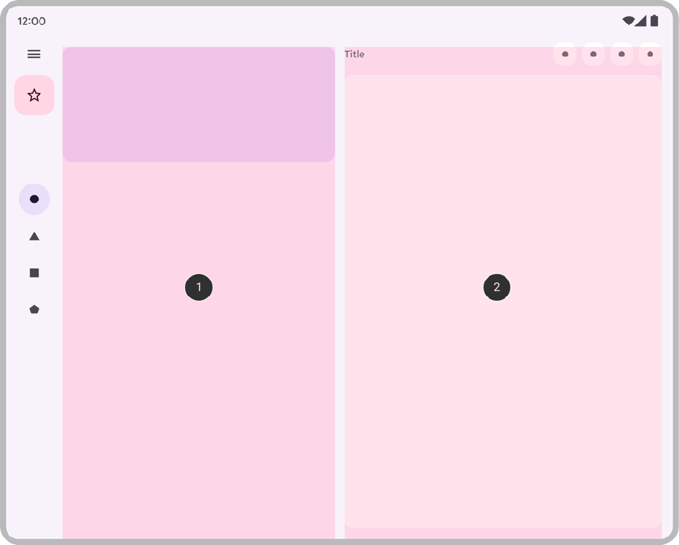
Flexible Layouts
@Composable fun AdaptivePane(
showOnePane: Boolean,
/* ... */
) {
if (showOnePane) { OnePane(/* ... */)
} else {
TwoPane(/* ... */)
}
}

Slide 42
Flexible Layouts
@Composable
fun Card(/* ... */) { BoxWithConstraints {
if (maxWidth < 400.dp) {
Column { Image(/* ... */)
Title(/* ... */)
}
} else {
Row {
Column { Title(/* ... */)
Description(/* ... */)
}
Image(/* ... */)
}
}
}
}

Slide 43

Flexible Layouts
@Composable
fun Card(/* ... */) { BoxWithConstraints {
if (maxWidth < 400.dp) {
Column { Image(/* ... */)
Title(/* ... */)
}
} else {
Row {
Column { Title(/* ... */)
Description(/* ... */)
}
Image(/* ... */)
}
}
}
}
https://developer.android.com/large-screens

Slide 44








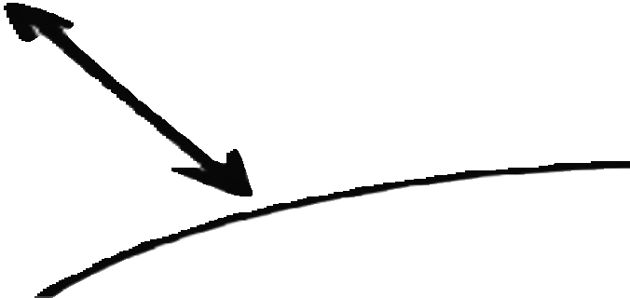
Lecture outcomes
Support diﬀerent screen, using layouts and fragments
ListView, RecyclerView, Progress Indicators
Retrieve data on background threads

