Slide 1

Course 1 – landscape of mobile application development

Slide 2

Prerequisites
Modern programming language
Object oriented
Statically types
IDE - IntelliJ/Android Studio

Slide 3








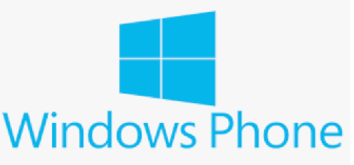

Options
2007
2008
2010

Slide 4









Native Options
2017
2008
2014
2007

Slide 5














Non-Native Options
2013
Hybrid App

Slide 6














Non-Native Options
Compiled App
2014
2015
2017

Slide 7









Timeline
2008
2011
2014
2017
2007
2013
2015

Slide 8








What to learn?

Slide 9
















Comparison
Write once, use everywhere
Write once
Write twice
Learn once, write everywhere
Learn once
Learn twice
Rich component library
All available
Write everything
Material Design

Slide 10














Comparison
Ecosystem/Resources
Plentiful
Scarse
Popularity
Hot
Cold
Performance
Native
Wrapper

Slide 11








Comparison
Access device features
Native
Wrapper
Real-World Usage
Everybody
First App

Slide 12






This year

Slide 13

Why Kotlin
Modern programming language
Object oriented
Lambdas, Coroutines, Properties
Since 2011
Open Sources 2012
Oﬃcial First Class Android Citizen since 2017
IntelliJ and Android Studio 3.0+

Slide 14

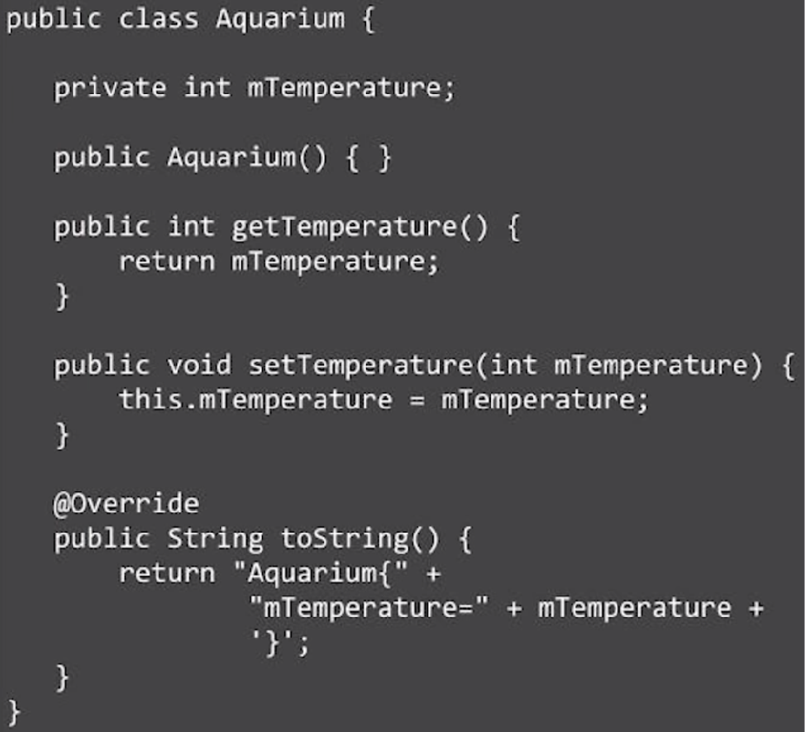
Why Kotlin
Java

Slide 15

Why Kotlin
Kotlin equivalent

Slide 16
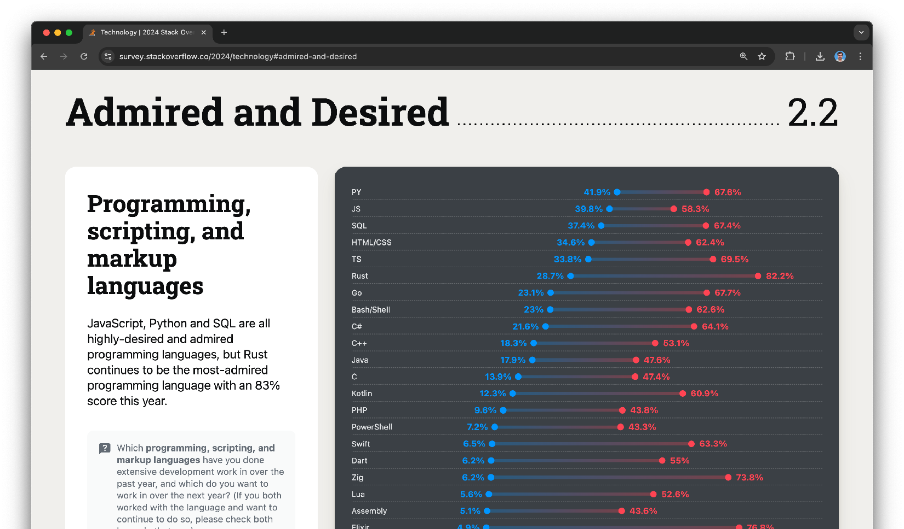


Why Kotlin

Slide 17
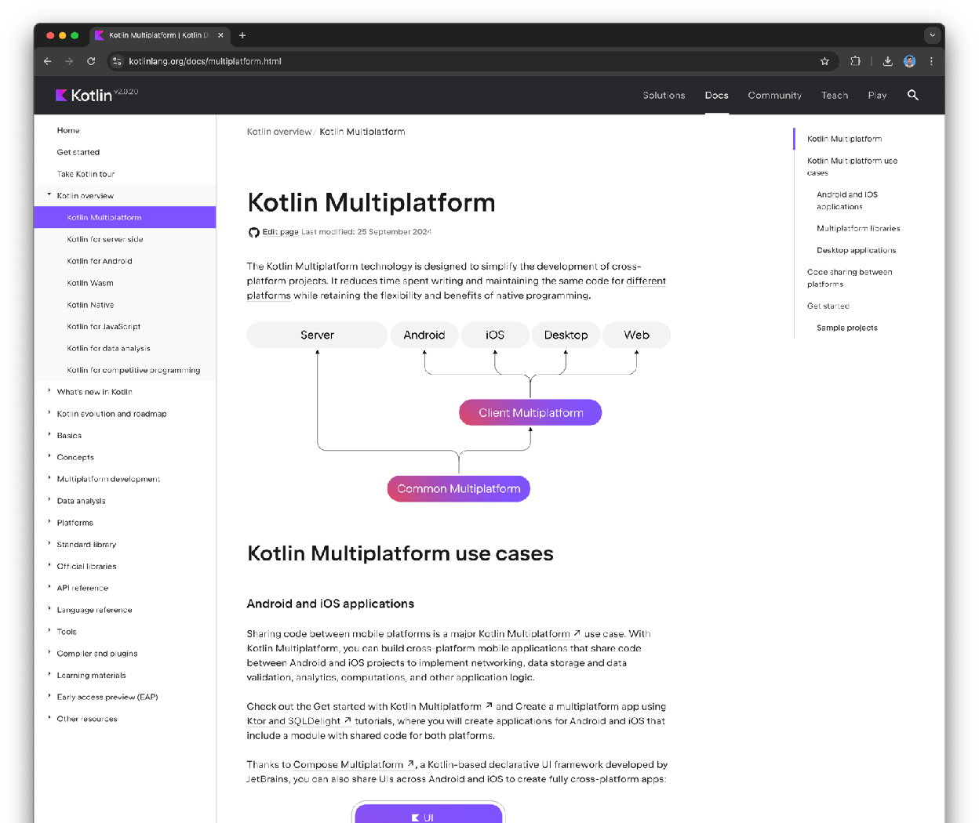

Why Kotlin

Slide 18
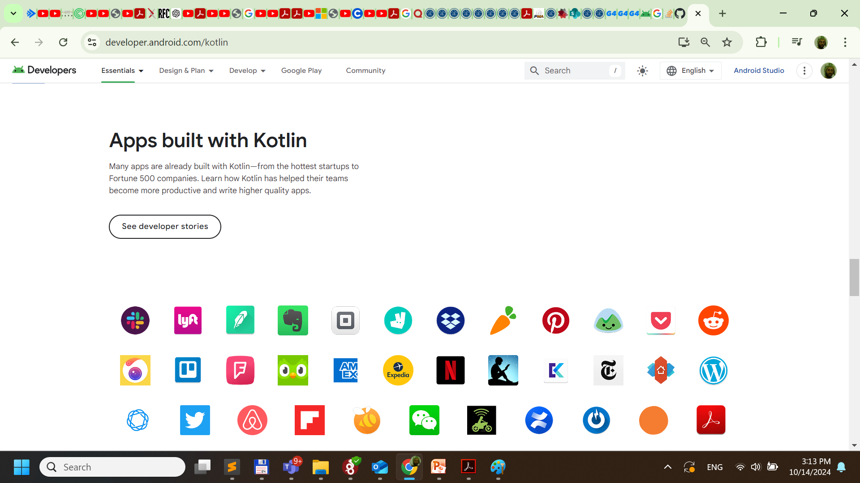
' '.

Slide 19

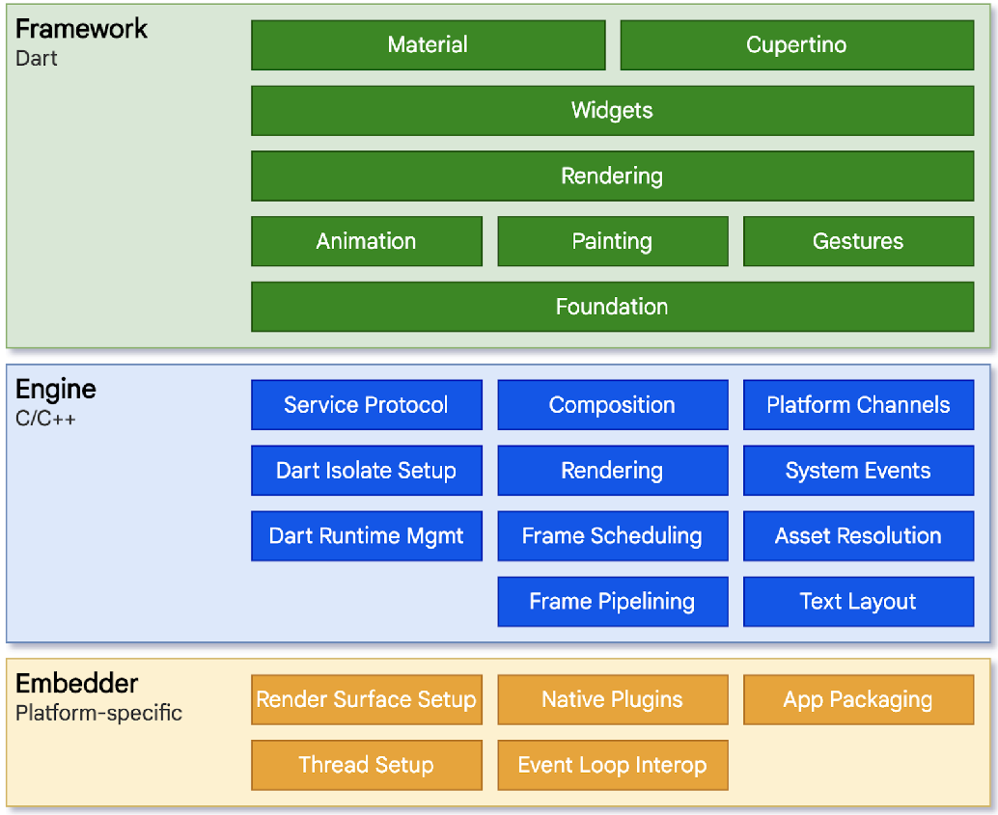
Why Flutter
Platform-agnostic
Simplifies and speeds application development
Easy to learn and easy to use
Scales well
Oﬀer an excellent user experience

Slide 20
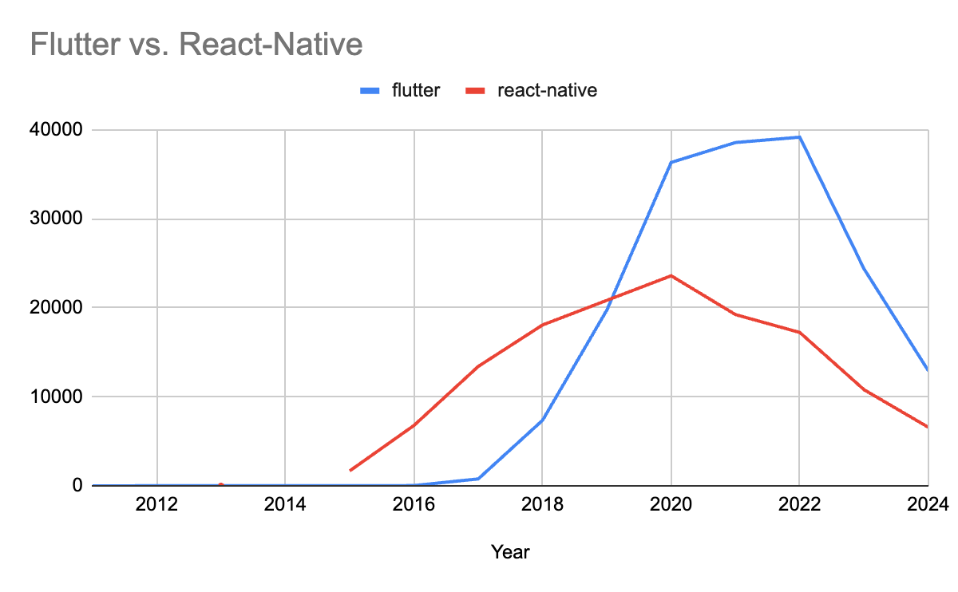
Why Flutter

Slide 21
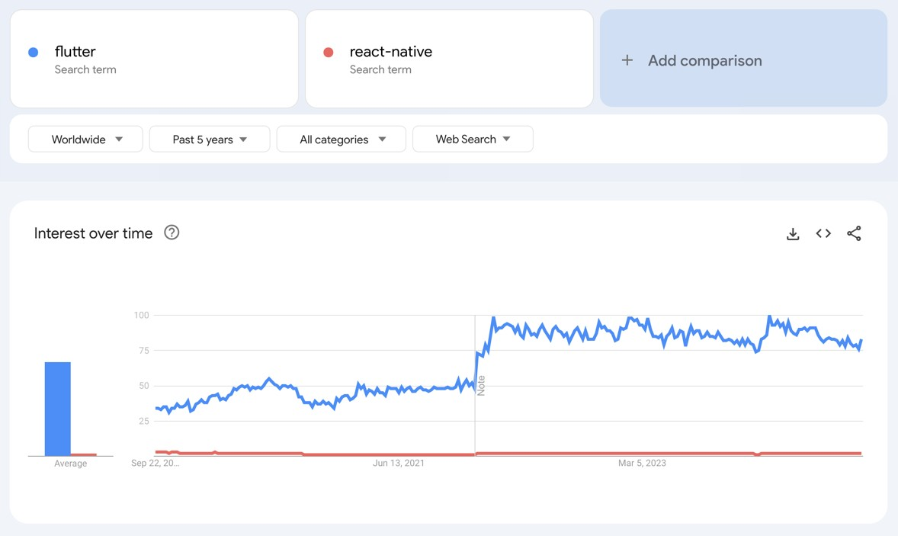
Why Flutter

Slide 22








Lecture outcomes
Understand the generated artifacts
Lifecycle of applications, activities and fragments.
Use logs to debug and study the behavior.

