Slide 1
Theoretical Fundamentals of Computer Science

Slide 2
First mechanical general purpose computers: Differential engine
Designed by Charles Babbage in 1822-1842
Not exactly a general purpose computer
Would compute polynomial functions by using the method of finite differences
Babbage built a small prototype in 1822
Babbage got a 1700 pounds grant from the British government in 1823 and abandoned the project in 1842 after spending 17000 pounds (due to technological problems)
Represented numbers in base 10; negative numbers are represented as ten’s complement

Slide 3

The method of finite differences
If a polynomial has degree k, then the k-th difference is constant
Ex.: assume we have f(x) = $2x^{3}−3x^{2}+x+1$ and we already know f(0)=1, f(1) = 1, f(2)=7, f(3)=31, f(4)=85
Advantage: no need for multiply/divide which are harder to implement
x | f(x) | D1(x) | D2(x) | D3(x)
0 | 1 | 0 | 6 | 12
1 | 1 | 6 | 18 | 12
2 | 7 | 24 | 30 | 12
3 | 31 | 54 | 42 | 12
4 | 85 | 96 |  | 12
5 | (181)? |  |  | 12

Slide 4
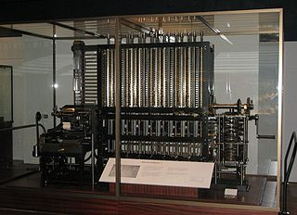
Differential engine (cont.)
Demo: https://www.youtube.com/watch?v=BlbQsKpq3Ak

Slide 5
Analytical engine
The 1st general purpose computational machine, 1837, Charles Babbage
Was never built
Incorporated arithmetic logic unit (Mill), conditional execution and loops, parallel programming
Had its own memory – Store - (able to store 1000 numbers of 40 decimal digits each ~ 16.2KB)
Input was on punched cards
Arithmetic operations: +, -, *, /, square root
Had internal procedures/functions and a sort of assembly language

Slide 6
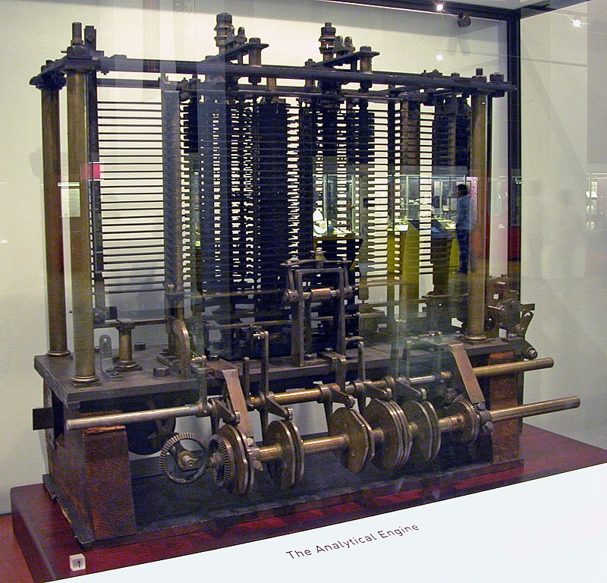
Analytical engine (cont.)

Slide 7
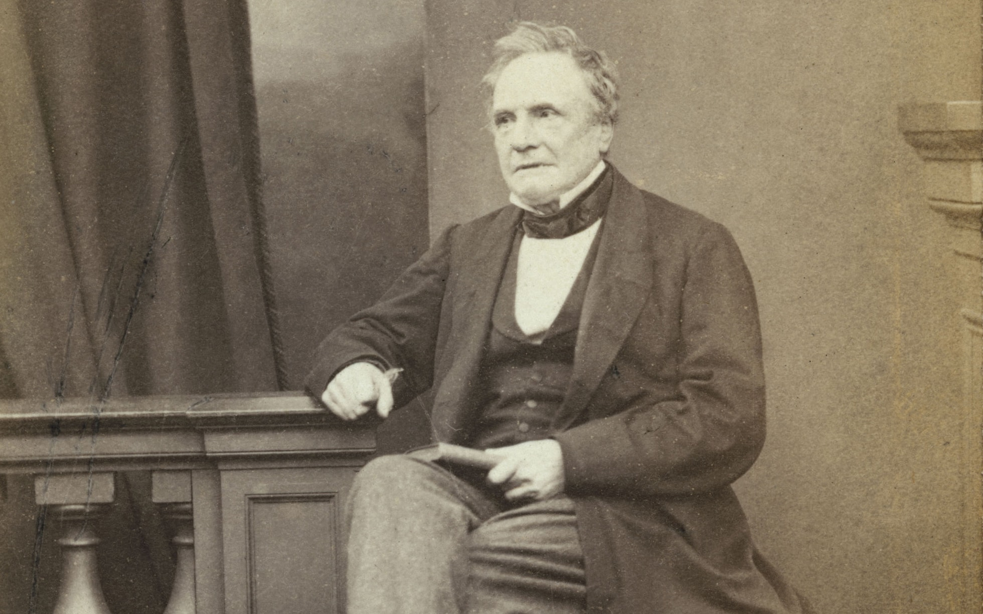
Charles Babbage,
1791-1871

Slide 8
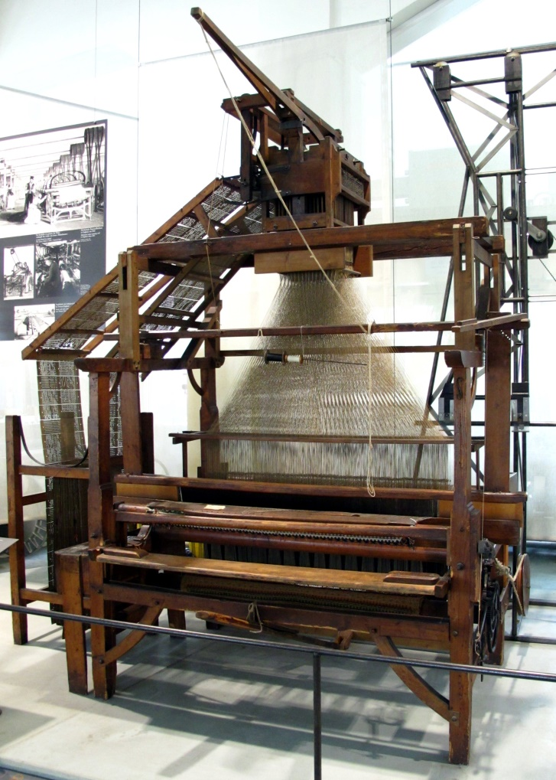
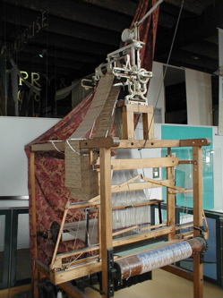
Joseph Marie Jacquard, looms, 1804

Slide 9
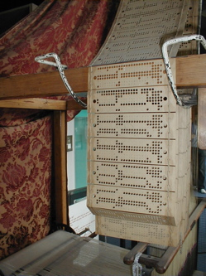
Jacquard’s loom, 1804

Slide 10
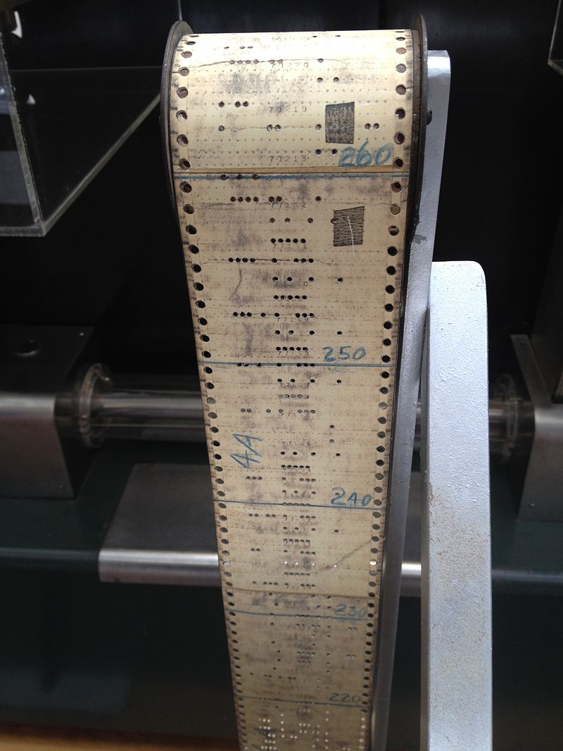
Old computer punched cards, 1944

Slide 11
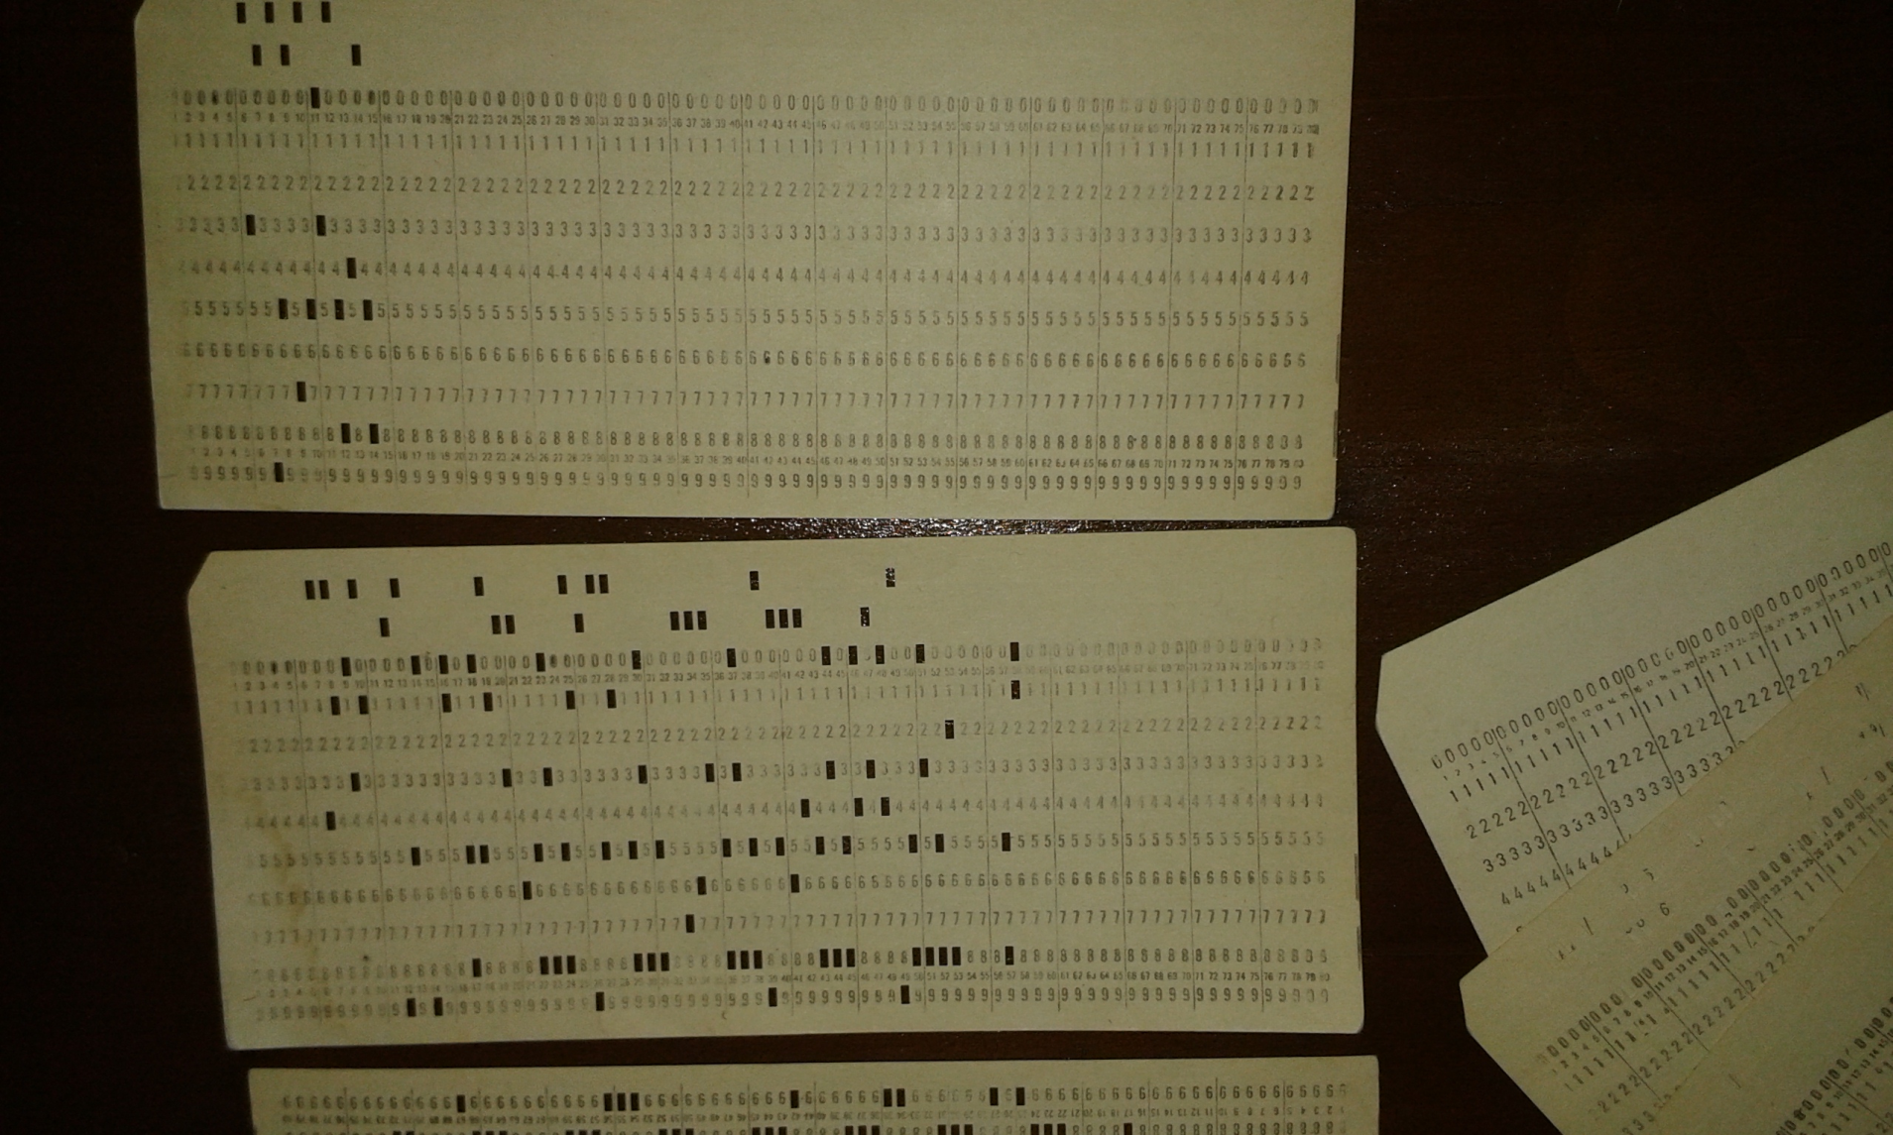
“Modern” Punched cards, 1990

Slide 12
Reading punched cards
There’s no standard for punched cards; different manufacturers use different formats
Most formats rely on 6-bit BCDIC code, where some bits represent a “zone” and the rest represent “an index in that zone”
A column always encodes one symbol (letter, digit etc.)
There are 9 rows for the “index” (1-9) and three rows for the “zone” (0, 11, 12) – 4 zones (0, 11, 12 or none punched)
An example of a format is at:
http://www.columbia.edu/cu/computinghistory/026.html

Slide 13
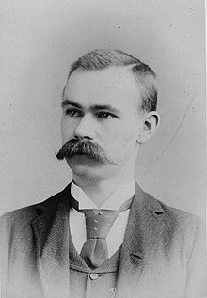
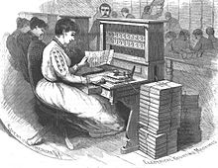
Herman Hollerith
Businessman, inventor, statistician
Worked for the United States Census Bureau

Slide 14
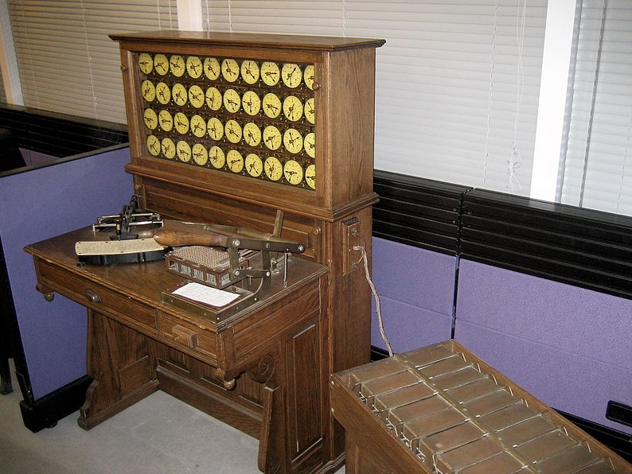
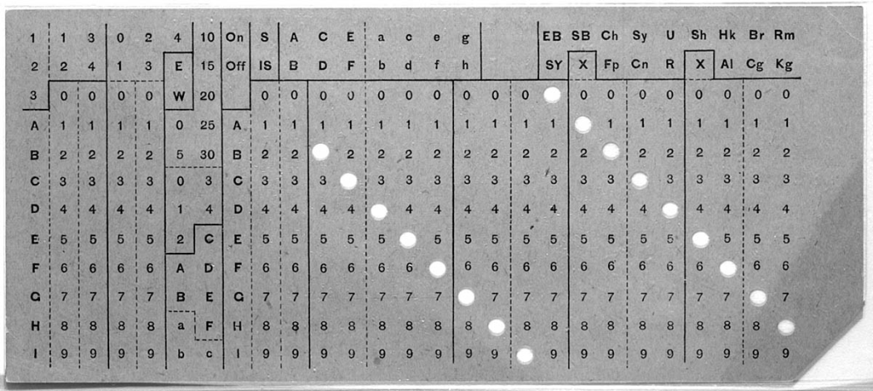
Herman Hollerith, 1890 census
Patented and created tabulating machines to be used in the 1890 US census – the census was completed 2 years before estimated time
Founded the Tabulating Machine Company which merged later with 4 other companies and formed IBM

Slide 15
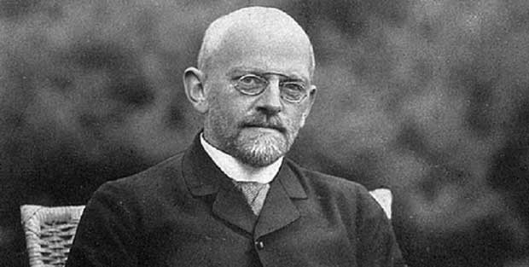
David Hilbert’s list of unsolved mathematical problems, 1900
1900, Paris, Math Conference – 10 initial problems
List is here (23 problems): http://mathworld.wolfram.com/HilbertsProblems.html
2nd problem:
Prove that the axioms of arithmetic are consistent.

Slide 16
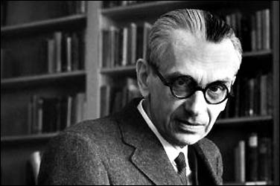
Kurt Goedel’s incompletness theorem, 1931
Could there exist, at least in principle, a definite method or process by which it could be decided whether any given mathematical assertion was provable? [Entscheidungsproblem]

Slide 17
Goedel’s incompletness theorems
1st theorem: no consistent system of axioms like the arithmetic system is capable of proving all available truths in the system (i.e. there are true statements about the natural numbers that can not be proven correct within the arithmetic system)
2nd theorem: the consistency of an axiomatic system can not be proven from within the system

Slide 18
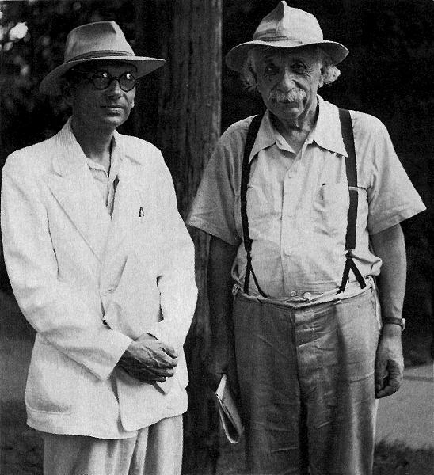
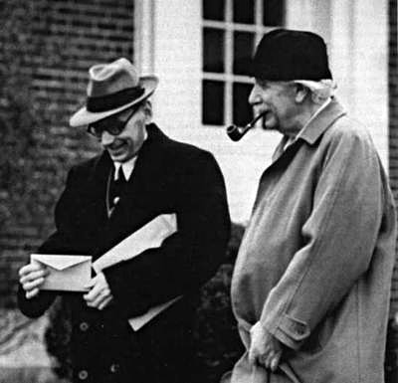
Kurt Goedel

Slide 19
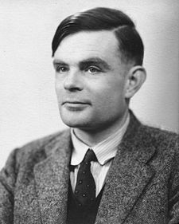
Alan Mathison Turing
1912-1954

Slide 20
Childhood
Interested in science at a young age; the interest of English public schools at that time was in literature and classics; headmaster of Sherborne School said: “If he is to be solely a Scientific Specialist, he is wasting his time at a Public School.”
Loved school: 1st day of schools, general strike => rode his bicycle unaccompanied 60 miles (97 km) from Southampton to Sherborne, stopping overnight at an inn
showed stunning abilities for mathematics at a young age: by age 15 he solved advanced math problems without studying elementary calculus; at age 16 he understood Einstein’s work on relativity

Slide 21
University studies
From 1931 to 1934 he studied at King's College, Cambridge
In 1935 at age 22 he was elected as Fellow of King’s College due to his dissertation (where he proved the Central Limit Theorem in Probability)
Wrote a paper “On Computable Numbers, with an Application to the Entscheidungsproblem” (1936) in which he proved Goedel’s theorem using Universal Turing Machines
In 1936 moved to Princeton Univ. and in 1938 he obtained a PhD in Mathematics under supervision of Alonzo Church
John von Neumann wanted to hire him as postdoc. assistant, but Alan Turing left for England.

Slide 22
Turing’s halting problem
Turing developed another proof of Kurt Goedel’s incompleteness theorem (after Goedel himself and Alonzo Church) by relating the decidability problem to the halting problem (for Turing machines)
Decidability problem = whether we can decide/prove that a statement is true or false
Halting problem = whether we can say/prove that any program-input data pair eventually terminates or not
Turing’s proof is based on reduction ad absurdum

Slide 23
Turing’s halting problem (cont.)
Turing actually proved 3 theorems
If there were a method/algorithm to prove that statement S is true or false, then a Turing machine M would be able to execute this method/algorithm and eventually terminate with the result true or false
There is no Turing machine M that can say for any arbitrary (computer program – input data) pair whether this program will finish running or will continue forever.
Example: if there exist a function halt(p) that determines whether program p terminates for any p (halt(p) returns true or false), consider the following p:
function p() {
if (halt(p)==true) { loop_forever() }
}
=> halt(p) gives contradictory results for the above example

Slide 24
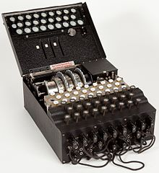
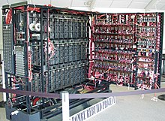
Alan Turing (war, the bombe)
German Enigma
Turing’s Bombe

Slide 25
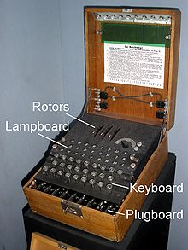
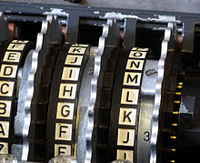
German Enigma chiper
Is a german encryption machine which scrambles the 26 letters of the alphabet
The 4-rotor variant has 10²² possible rotor settings
When a key is pressed, one or more rotors rotate, on one side of rotors are 26 electrical
contacts which
connect with the
electrical contacts
of the next rotor; so
each key forms an electrical pathway

Slide 26
The bombe
Enigma was decripted by polish agents in 1932
Meanwhile the Germans added improvements to Enigma that made it harder to decrypt
In 1939, the Polish shared their knowledge with the British forces
Alan Turing redesigned the bombe at Bletchley Park which was able to decrypt Enigma
A bombe contained 26 Enigma simulators and can execute jobs in parallel; it is an electro-mechanical device

Slide 27
The bombe (cont.)
The bombe performs a known plaintext attack using a crib (a word that is known to appear in the encrypted message; e.g. ‘Heil Hitler’, ‘weather’ in weather reports)
The bomb would simulate Enigma and detect contradictions (i.e. a letter being encrypted to itself, impossible) and eliminate those settings
A few settings would remain that needed to be investigated by hand
It is assumed that the decryption work of Alan Turing at Bletchley Park has shorten the war by two years
Turing also built other decryption devices at Bletchley Park

Slide 28
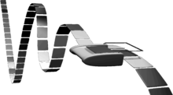
Alan Turing (Universal Turing Machine), 1937

Slide 29
Universal Turing Machine
Is a mathematical model of an abstract computing machine (i.e. a computer)
The machine processes a tape which contains symbols and is used as an input and output device
The machine reads 1 symbol from the input tape and depending on this symbol and the internal state it can shift the tape with one position to the left or to the right; it can also write a symbol on this tape

Slide 30
Turing machine, formal definition
A Turing machine is similar to an automaton , it is a tuple M=(S, A, b, Σ, T, s₀, F) where:
S is a finite, non-empty set of states
A is a finite non-empty set of tape alphabet symbols
b ϵ A is the black symbol (the only symbol allowed to occur on the tape infinitely often at any step during the computation)
Σ ⸦ A\{b} is the set of input symbols (that can appear on the input tape)
s₀ ϵ S is the initial state
F ⸦ S is the set of final/accepting states
T : (S \ F) x A → S x A x {L,R} is a transition function, L is a left shift, R is a right shift. If T is not defined on the current state and the current tape symbol, then the machine M halts.

Slide 31
Turing’s AI test
A human user should not be able to tell is a human or a computer is in the other room answering his/her questions
CAPCHA is a reverse Turing test

Slide 32
Alan Turing
(other notable facts)
Won several athletic contests
Created the Turing artificial intelligence test

Slide 33
Turing’s death
Alan Turing was homosexual
In 1952 he was convicted for indecency (being homosexual was illegal at that time in England)
He was offered a choice of imprisonment or hormonal therapy
He accepted hormonal therapy which changed his body
In 1954 he was found death of cyanide poisoning – most probable suicide
In 2009 and following years, the British government and the Queen issued apology and pardon for the way Alan Turing was treated
The most famous prize in Computer Science bears the name of Alan Turing (i.e. the ACM Turing award).

Slide 34
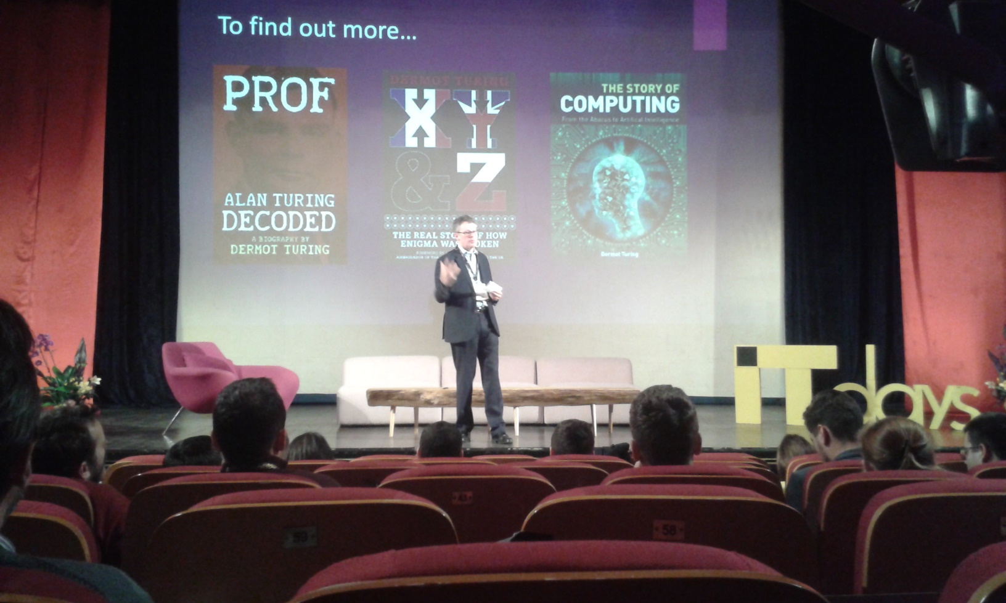
Alan Turing’s legacy
His nephew, Dermot Turing makes presentations all over the world about Alan Turing’s work.

Slide 35
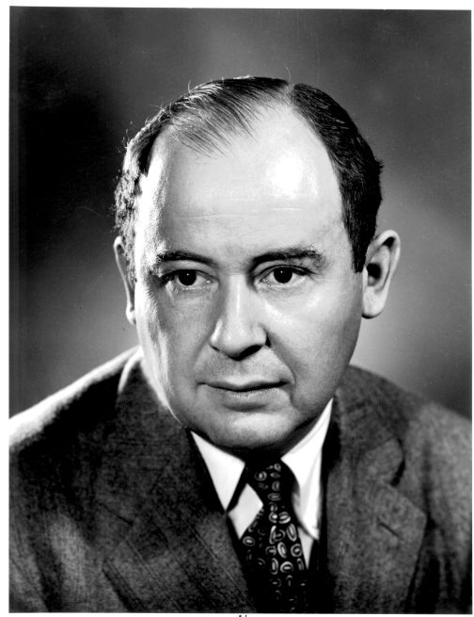
John von Neumann,
1903-1957

Slide 36
John von Neumann
Hungarian-American mathematician, physicist, computer scientist, engineer and polymath
He made contributions in a large number of fields, mathematics (foundation of mathematics, ergodic theory, functional analysis, statistics etc.), physics (quantum mechanics, nuclear), economics (game theory), computing (von Neumann architecture, linear programming)
Published over 150 papers
He was part of “the martians” - Paul Erdos, Paul Halmos, Theodore von Karman, John G. Kemeny, John von Neumann, George Polya, Leo Szilard, Edward Teller, and Eugene Wigner

Slide 37
Childhood
Born in Budapest
von Neumann was a child prodigy: at 6 yers old, he could divide two 8-digit numbers in his head and could speak ancient greek, by age 8 he was familiar with differential and integral calculus
He studied at public Lutheran Fasori Evangélikus Gimnázium, but also had private tutors – at age 15 he studied advanced calculus with the renowned Gabor Szego and on their first meeting he was brought to tears by the boy’s mathematical talent
By age 19 he published 2 major math papers, in one he gave the modern definition of ordinal numbers (which superseded Cantor’s definition)

Slide 38
University studies
In 1923 he entered Pázmány Péter University in Budapest as PhD candidate in mathematics and ETH Zurich as chemical engineering student (to please his father who wanted to follow him in the industry)
He completed his habilitation in math in 1927 and started lecturing as privatdozent at Univ. of Berlin in 1928 (the youngest person ever elected in the history of the univ. on any subject)
By 1929 he published 32 major papers in mathematics (at a rate of nearly 1 major paper per month in the last 2 years)
In 1929 he moved to Princeton University, US – in 1933 he was offered lifetime professorship

Slide 39
Manhattan project
Between 1940-1946, von Neumann worked on the Manhattan Project at Los Alamos
He designed explosive lenses and the spherical shape of the nuclear bombe
Because of the nuclear tests he was diagnosed with bone, pancreatic or prostate cancer and died in 1957 under military security due to all the secrets he knew

Slide 40
Computer Science contributions
He invented the merge sort algorithm in 1945
Was a consultant for the powerful ENIAC and EDVAC american supercomputers
While consulting for EDVAC he described a computer architecture where program and data are both stored in the memory

Slide 41
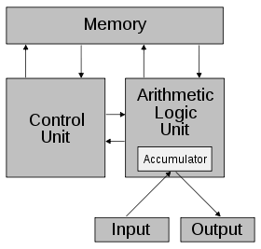
John von Neumann’s stored-program computer, 1947

Slide 42
von Neumann fun facts
He could quickly memorize whole pages from telephone books and would entertain friends by reciting addresses, numbers and names from this pages
He was socially active (threw parties at his house), was married two times, took great care in his clothing, always wore formal suits
Was a bad driver (usually drove while reading, causing arrests and accidents), drove many cars
Liked to eat and drink
Liked working in loud environments; there were many complaints from fellow scientists at Princeton (including Albert Einstein) of Neumann playing loud music at his gramophone

