Slide 1
Computer Networks Routing
Adrian Sergiu DARABANT
Lecture 9

Slide 2
Routing tables (static)
Destination | Gateway | Genmask | Flags | Metric | Ref | Use | Iface
172.16.25.1 | 172.30.0.4 | 255.255.255.255 | UGH | 0 | 0 | 0 | Eth1
193.226.40.128 | 0.0.0.0 | 255.255.255.224 | U | 0 | 0 |  | Eth0
193.0.225.0 | 0.0.0.0 | 255.255.255.0 | U | 0 | 0 |  | Eth0
193.231.20.0 | 0.0.0.0 | 255.255.255.0 | U | 0 | 0 |  | Eth0
172.30.0.0 | 0.0.0.0 | 255.255.0.0 | U | 0 | 0 |  | Eth1
169.254.0.0 | 0.0.0.0 | 255.255.0.0 | U | 0 | 0 |  | Eth1
0.0.0.0 | 193.0.225.9 | 0.0.0.0 | UG | 0 | 0 |  | Eth0
The route command – (Windows/Linux/other OS)

Slide 3
Routing protocols
mobile network
Routing protocol goal: determine “good” paths (equivalently, routes), from sending hosts to receiving host, through network of routers
path: sequence of routers packets traverse from given initial source host to final destination host
“good”: least “cost”, “fastest”, “least congested”
routing: a “top-10” networking challenge!
national or global ISP
application
transport
network
link
physical
network
link
physical
network
link
physical
network
link
physical
network
link
physical
network
link
physical
datacenter
network
application
transport
network
link
physical
enterprise
network

Slide 4
Graph abstraction: link costs
5
c_{a,b}: cost of direct link connecting a and b
e.g., c_{w,z} = 5, c_{u,z} = ∞
cost defined by network operator: could always be 1, or inversely related to bandwidth, or inversely related to congestion
v
3
w
2
5
u
2
1
z
3
1
x
2
1
y
graph: G = (N,E)
N: set of routers = { u, v, w, x, y, z }
E: set of links ={ (u,v), (u,x), (v,x), (v,w), (x,w), (x,y), (w,y), (w,z), (y,z) }

Slide 5
Routing algorithm classification
global: all routers have complete topology, link cost info
“link state” algorithms
How fast do routes change?
dynamic: routes change more quickly
periodic updates or in response to link cost changes
static: routes change slowly over time
decentralized: iterative process of computation, exchange of info with neighbors
routers initially only know link costs to attached neighbors
“distance vector” algorithms
global or decentralized information?

Slide 6
Distance vector algorithm
Based on Bellman-Ford (BF) equation (dynamic programming):
Bellman-Ford equation
Let D_{x}(y): cost of least-cost path from x to y.
Then:
D_{x}(y) = min_{v} { c_{x,v} + D_{v}(y) }
v’s estimated least-cost-path cost to y
min taken over all neighbors v of x
direct cost of link from x to v

Slide 7
RIP-Distance vector algorithm
key idea:
from time-to-time, each node sends its own distance vector estimate to neighbors
when x receives new DV estimate from any neighbor, it updates its own DV using B-F equation:
D_{x}(y) ← min_{v}{c_{x,v} + D_{v}(y)} for each node y ∊ N
under minor, natural conditions, the estimate D_{x}(y) converge to the actual least cost d_{x}(y)

Slide 8
Distance vector algorithm:
each node:
iterative, asynchronous: each local iteration caused by:
local link cost change
DV update message from neighbor
wait for (change in local link cost or msg from neighbor)
recompute DV estimates using DV received from neighbor
distributed, self-stopping: each node notifies neighbors only when its DV changes
neighbors then notify their neighbors – only if necessary
no notification received, no actions taken!
if DV to any destination has changed, notify neighbors

Slide 9
Distance Table: example
1
cost to destination via
B
C
E
7
D ()
A
B
C
D
A
1
7
6
4
B
14
8
9
11
D
5
5
4
2
A
8
2
1
E
D
2
E
D
D (C,D)
=
c(E,D) + min {D (C,w)}
destination
w
=
2+2 = 4
E
D
D (A,D)
=
c(E,D) + min {D (A,w)}
w
=
2+3 = 5
loop!
E
B
D (A,B)
=
c(E,B) + min {D (A,w)}
w
=
8+6 = 14
loop!

Slide 10
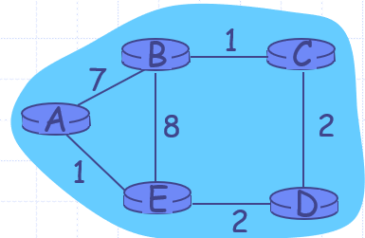
Distance table gives routing table
A | Next Hop | Dist
B | - | 7
C | - | ∞
D | - | ∞
E | - | 1
B | Next Hop | Dist
A | - | 7
C | - | 1
D | - | ∞
E | - | 8
C | Next Hop | Dist
A | - | ∞
B | - | 1
D | - | 2
E | - | ∞
D | Next Hop | Dist
A | - | ∞
B | - | ∞
C | - | 2
E | - | 2
E | Next Hop | Dist
A | - | 1
B | - | 8
C | - | ∞
D | - | 2
A | Next Hop | Dist
B | - | 7
C | B | 8
D | E | 3
E | - | 1
B | Next Hop | Dist
A | - | 7
C | - | 1
D | C | 3
E | - | 8
C | Next Hop | Dist
A | B | 8
B | - | 1
D | - | 2
E | D | 4
D | Next Hop | Dist
A | E | 3
B | C | 3
C | - | 2
E | - | 2
E | Next Hop | Dist
A | - | 1
B | - | 8
C | D | 4
D | - | 2
Distance table
Routing table

Slide 11
Distance Vector routing
A | Next Hop | Dist
B | - | 7
C | E | 5
D | E | 3
E | - | 1
B | Next Hop | Dist
A | - | 7
C | - | 1
D | C | 3
E | C | 5
C | Next Hop | Dist
A | D | 5
B | - | 1
D | - | 2
E | D | 4
D | Next Hop | Dist
A | E | 3
B | C | 3
C | - | 2
E | - | 2
E | Next Hop | Dist
A | - | 1
B | D | 5
C | D | 4
D | - | 2
A | Next Hop | Dist
B | E | 6
C | E | 5
D | E | 3
E | - | 1
B | Next Hop | Dist
A | C | 6
C | - | 1
D | C | 3
E | C | 5
C | Next Hop | Dist
A | D | 5
B | - | 1
D | - | 2
E | D | 4
D | Next Hop | Dist
A | E | 3
B | C | 3
C | - | 2
E | - | 2
E | Next Hop | Dist
A | - | 1
B | D | 5
C | D | 4
D | - | 2
B
1
C
7
A
8
2
1
E
D
2

Slide 12
Distance Vector
B
1
C
7
A
8
2
1
E
D
2
A | Next Hop | Dist
B | E | 6
C | E | 5
D | E | 3
E | - | 1
B | Next Hop | Dist
A | C | 6
C | - | 1
D | C | 3
E | C | 5
C | Next Hop | Dist
A | D | 5
B | - | 1
D | - | 2
E | D | 4
D | Next Hop | Dist
A | E | 3
B | C | 3
C | - | 2
E | - | 2
E | Next Hop | Dist
A | - | 1
B | D | 5
C | D | 4
D | - | 2

Slide 13
Count to Infinity & Solution ?
Good news travels fast
Bad news is slow
Count to infinity !
Poison reverse
Split Horizon

Slide 14
Distance Vector Algorithm:
At all nodes, X:
1 Initialization:
2 for all adjacent nodes v:
3 D (*,v) = infinity /* the * operator means "for all rows" */
4 D (v,v) = c(X,v)
5 for all destinations, y
6 send min D (y,w) to each neighbor /* w over all X's neighbors */
X
X
X
w

Slide 15
Distance Vector Algorithm (cont.):
8 loop
9 wait (until I see a link cost change to neighbor V
10 or until I receive update from neighbor V)
11
12 if (c(X,V) changes by d)
13 /* change cost to all dest's via neighbor v by d */
14 /* note: d could be positive or negative */
15 for all destinations y: D (y,V) = D (y,V) + d
16
17 else if (update received from V wrt destination Y)
18 /* shortest path from V to some Y has changed */
19 /* V has sent a new value for its min DV(Y,w) */
20 /* call this received new value is "newval" */
21 for the single destination y: D (Y,V) = c(X,V) + newval
22
23 if we have a new min D (Y,w)for any destination Y
24 send new value of min D (Y,w) to all neighbors
25
26 forever
X
X
w
X
X
w
X
w

Slide 16
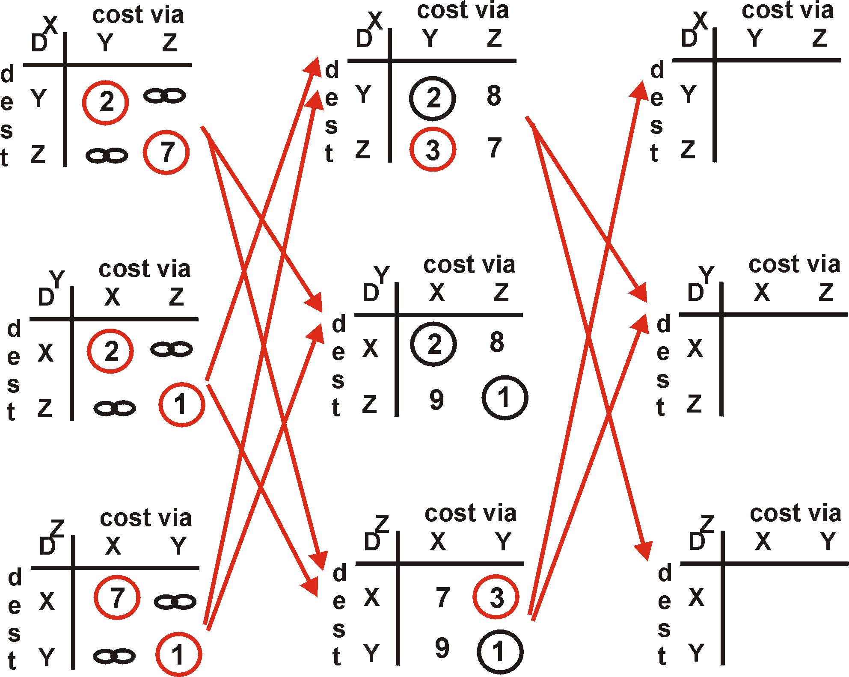
Distance Vector Algorithm: example
Y
2
1
X
Z
7

Slide 17
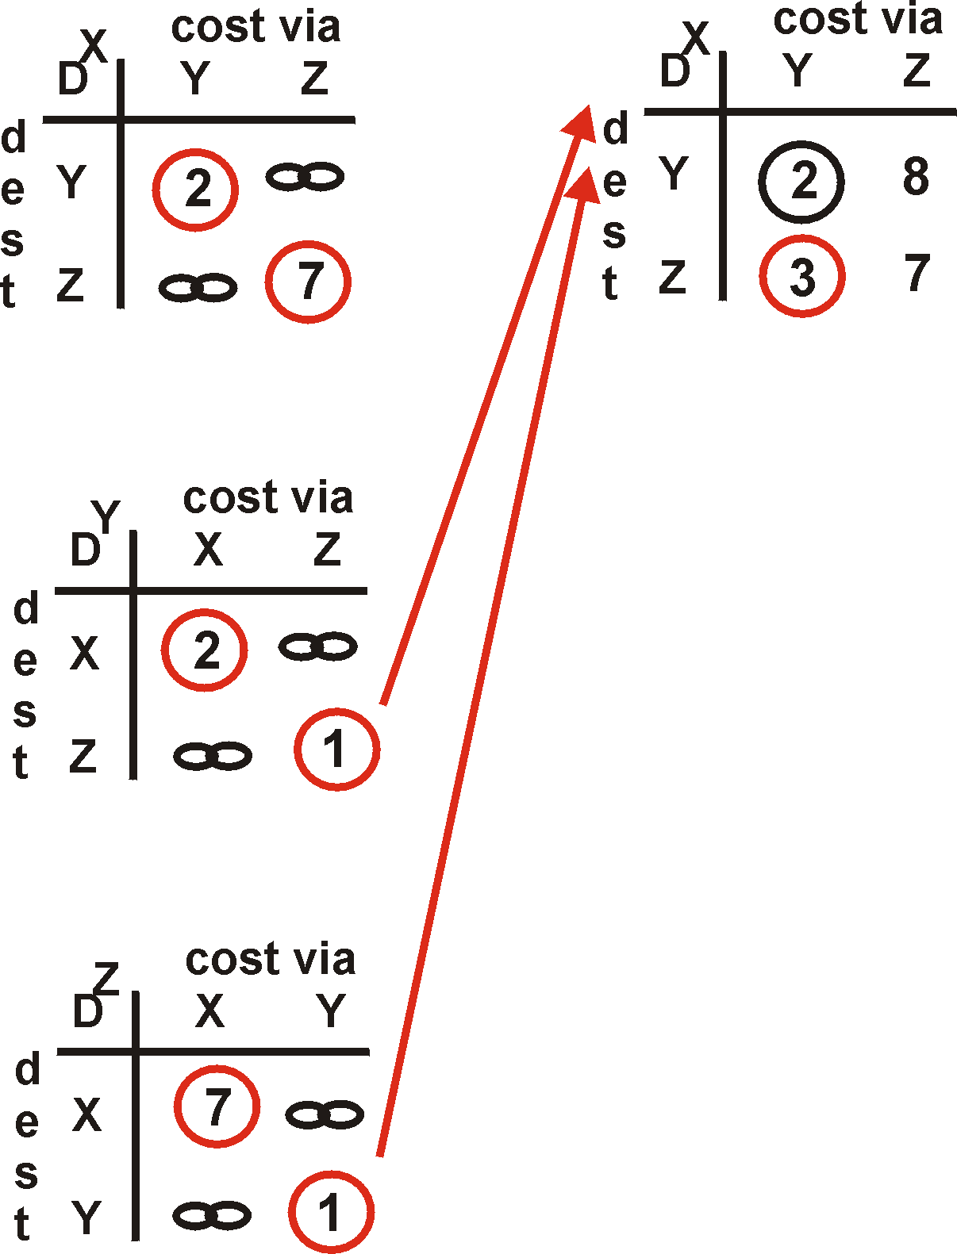
Distance Vector Algorithm: example
Y
2
1
X
Z
X
Z
7
D (Y,Z)
=
c(X,Z) + min {D (Y,w)}
w
=
7+1 = 8
X
Y
D (Z,Y)
=
c(X,Y) + min {D (Z,w)}
w
=
2+1 = 3

Slide 18
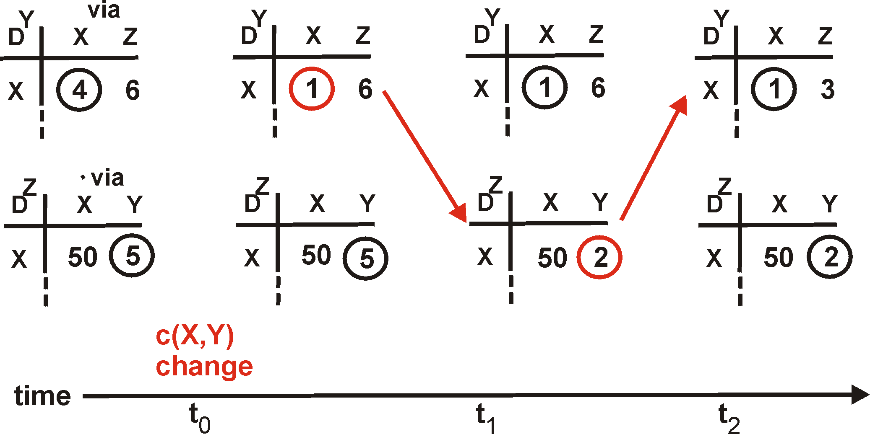
Distance Vector: link cost changes
Link cost changes:
node detects local link cost change
updates distance table (line 15)
if cost change in least cost path, notify neighbors (lines 23,24)
1
Y
4
1
X
Z
50
algorithm
terminates
“good
news
travels
fast”

Slide 19
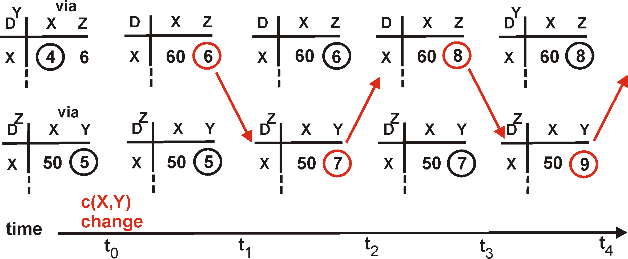
Distance Vector: link cost changes
Link cost changes:
good news travels fast
bad news travels slow - “count to infinity” problem!
60
Y
4
1
X
Z
50
algorithm
continues
on!

Slide 20
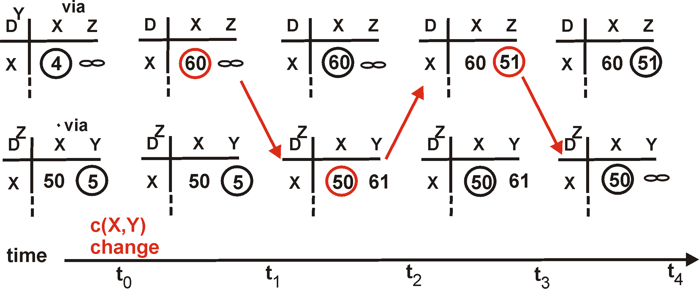
Distance Vector: poisoned reverse
If Z routes through Y to get to X :
Z tells Y its (Z’s) distance to X is infinite (so Y won’t route to X via Z)
will this completely solve count to infinity problem?
60
Y
4
1
X
Z
50
algorithm
terminates

Slide 21
Comparison of LS and DV algorithms
Message complexity
LS: with n nodes, E links, O(nE) msgs sent each
DV: exchange between neighbors only
convergence time varies
Speed of Convergence
LS: O(n²) algorithm requires O(nE) msgs
may have oscillations
DV: convergence time varies
may be routing loops
count-to-infinity problem
Robustness: what happens if router malfunctions?
LS:
node can advertise incorrect link cost
each node computes only its own table
DV:
DV node can advertise incorrect path cost
each node’s table used by others
error propagate thru network

Slide 22
Making routing scalable
our routing study thus far - idealized
all routers identical
network “flat”
… not true in practice
scale: billions of destinations:
can’t store all destinations in routing tables!
routing table exchange would swamp links!
administrative autonomy:
Internet: a network of networks
each network admin may want to control routing in its own network

Slide 23
Internet approach to scalable routing
aggregate routers into regions known as “autonomous systems” (AS) (a.k.a. “domains”)
intra-AS (aka “intra-domain”): routing among within same AS (“network”)
all routers in AS must run same intra-domain protocol
routers in different AS can run different intra-domain routing protocols
gateway router: at “edge” of its own AS, has link(s) to router(s) in other AS’es
inter-AS (aka “inter-domain”): routing among AS’es
gateways perform inter-domain routing (as well as intra-domain routing)

Slide 24
Interconnected ASes
forwarding table configured by intra- and inter-AS routing algorithms
Intra-AS
Routing
Inter-AS
Routing
forwarding
table
intra-AS routing determine entries for destinations within AS
inter-AS & intra-AS determine entries for external destinations
intra-AS
routing
3c
inter-AS routing
3a
2c
3b
intra-AS
routing
2a
2b
AS3
1c
1a
intra-AS
routing
1d
1b
AS2
AS1

Slide 25
Inter-AS routing: a role in intradomain forwarding
suppose router in AS1 receives datagram destined outside of AS1:
AS1 inter-domain routing must:
learn which destinations reachable through AS2, which through AS3
propagate this reachability info to all routers in AS1
router should forward packet to gateway router in AS1, but which one?
3c
3a
2c
other
networks
3b
2a
2b
AS3
1c
other
networks
1a
1b
AS2
1d
AS1

Slide 26
Inter-AS routing: routing within an AS
most common intra-AS routing protocols:
RIP: Routing Information Protocol [RFC 1723]
classic DV: DVs exchanged every 30 secs
no longer that widely used
EIGRP: Enhanced Interior Gateway Routing Protocol
DV based
formerly Cisco-proprietary for decades (became open in 2013 [RFC 7868])
OSPF: Open Shortest Path First [RFC 2328]
link-state routing
IS-IS protocol (ISO standard, not RFC standard) essentially same as OSPF

Slide 27
OSPF (Open Shortest Path First) routing
“open”: publicly available
classic link-state
each router floods OSPF link-state advertisements (directly over IP rather than using TCP/UDP) to all other routers in entire AS
multiple link costs metrics possible: bandwidth, delay
each router has full topology, uses Dijkstra’s algorithm to compute forwarding table
security: all OSPF messages authenticated (to prevent malicious intrusion)

Slide 28
Hierarchical OSPF
two-level hierarchy: local area, backbone.
link-state advertisements flooded only in area, or backbone
each node has detailed area topology; only knows direction to reach other destinations
area border routers: “summarize” distances to destinations in own area, advertise in backbone
boundary router: connects to other ASes
backbone
backbone router: runs OSPF limited to backbone
local routers:
flood LS in area only
compute routing within area
forward packets to outside via area border router
area 3
internal
routers
area 1
area 2

Slide 29
Internet inter-AS routing: BGP
BGP (Border Gateway Protocol): the de facto inter-domain routing protocol
“glue that holds the Internet together”
allows subnet to advertise its existence, and the destinations it can reach, to rest of Internet: “I am here, here is who I can reach, and how”
BGP provides each AS a means to:
eBGP: obtain subnet reachability information from neighboring ASes
iBGP: propagate reachability information to all AS-internal routers.
determine “good” routes to other networks based on reachability information and policy

Slide 30
eBGP, iBGP connections
2b
2a
∂
1b
2c
3b
2d
∂
1a
1c
3a
3c
AS 2
1d
3d
AS 1
eBGP connectivity
AS 3
logical iBGP connectivity
1c
gateway routers run both eBGP and iBGP protocols

Slide 31
BGP basics
BGP session: two BGP routers (“peers”) exchange BGP messages over semi-permanent TCP connection:
advertising paths to different destination network prefixes (BGP is a “path vector” protocol)
when AS3 gateway 3a advertises path AS3,X to AS2 gateway 2c:
AS3 promises to AS2 it will forward datagrams towards X
AS 3
3b
AS 1
1b
3a
3c
1a
1c
AS 2
2b
3d
1d
2a
2c
BGP advertisement:
AS3, X
X
2d

Slide 32
Path attributes and BGP routes
BGP advertised route: prefix + attributes
prefix: destination being advertised
two important attributes:
AS-PATH: list of ASes through which prefix advertisement has passed
NEXT-HOP: indicates specific internal-AS router to next-hop AS
policy-based routing:
gateway receiving route advertisement uses import policy to accept/decline path (e.g., never route through AS Y).
AS policy also determines whether to advertise path to other other neighboring ASes

Slide 33
BGP path advertisement
AS 3
3b
AS 1
1b
3a
3c
1a
1c
AS 2
2b
3d
X
1d
2a
2c
AS3, X
AS2,AS3,X
2d
AS2 router 2c receives path advertisement AS3,X (via eBGP) from AS3 router 3a
based on AS2 policy, AS2 router 2c accepts path AS3,X, propagates (via iBGP) to all AS2 routers
based on AS2 policy, AS2 router 2a advertises (via eBGP) path AS2, AS3, X to AS1 router 1c

Slide 34
BGP path advertisement (more)
AS 3
3b
AS 1
1b
AS3,X
3a
3c
AS3,X
1a
AS3,X
1c
AS 2
2b
3d
X
AS3,X
1d
2a
2c
AS3, X
AS2,AS3,X
2d
gateway router may learn about multiple paths to destination:
AS1 gateway router 1c learns path AS2,AS3,X from 2a
AS1 gateway router 1c learns path AS3,X from 3a
based on policy, AS1 gateway router 1c chooses path AS3,X and advertises path within AS1 via iBGP

Slide 35
BGP messages
BGP messages exchanged between peers over TCP connection
BGP messages:
OPEN: opens TCP connection to remote BGP peer and authenticates sending BGP peer
UPDATE: advertises new path (or withdraws old)
KEEPALIVE: keeps connection alive in absence of UPDATES; also ACKs OPEN request
NOTIFICATION: reports errors in previous msg; also used to close connection

Slide 36
BGP path advertisement
AS 3
3b
AS 1
1b
AS3,X
3a
3c
1
AS3,X
1a
AS3,X
1c
AS 2
3d
X
2
2b
local link interfaces
at 1a, 1d
AS3,X
2
1d
1
AS3, X
AS2,AS3,X
2a
2c
2d
dest
interface
recall: 1a, 1b, 1d learn via iBGP from 1c: “path to X goes through 1c”
…
…
1c
1
at 1d: OSPF intra-domain routing: to get to 1c, use interface 1
X
1
…
…
at 1d: to get to X, use interface 1

Slide 37
BGP path advertisement
AS 3
3b
AS 1
1b
3a
3c
1
1a
1c
AS 2
2b
3d
X
2
1d
2a
2c
2d
dest
interface
recall: 1a, 1b, 1d learn via iBGP from 1c: “path to X goes through 1c”
…
…
1c
2
at 1d: OSPF intra-domain routing: to get to 1c, use interface 1
X
2
at 1d: to get to X, use interface 1
…
…
at 1a: OSPF intra-domain routing: to get to 1c, use interface 2
at 1a: to get to X, use interface 2

Slide 38
Why different Intra-, Inter-AS routing ?
policy:
inter-AS: admin wants control over how its traffic routed, who routes through its network
intra-AS: single admin, so policy less of an issue
scale:
hierarchical routing saves table size, reduced update traffic
performance:
intra-AS: can focus on performance
inter-AS: policy dominates over performance

Slide 39
Hot potato routing
AS 3
3b
AS 1
1b
3a
3c
1a
1c
AS 2
2b
3d
X
112
1d
AS1,AS3,X
2a
2c
AS3,X
201
263
2d
OSPF link weights
2d learns (via iBGP) it can route to X via 2a or 2c
hot potato routing: choose local gateway that has least intra-domain cost (e.g., 2d chooses 2a, even though more AS hops to X): don’t worry about inter-domain cost!

Slide 40
BGP: achieving policy via advertisements
A,w
B
x
provider
w
A
network
legend:
C
y
customer
A,w
network:
ISP only wants to route traffic to/from its customer networks (does not want to carry transit traffic between other ISPs – a typical “real world” policy)
A advertises path Aw to B and to C
B chooses not to advertise BAw to C!
B gets no “revenue” for routing CBAw, since none of C, A, w are B’s customers
C does not learn about CBAw path
C will route CAw (not using B) to get to w

Slide 41
BGP: achieving policy via advertisements (more)
B
x
provider
w
A
network
legend:
C
y
customer
network:
ISP only wants to route traffic to/from its customer networks (does not want to carry transit traffic between other ISPs – a typical “real world” policy)
A,B,C are provider networks
x,w,y are customer (of provider networks)
x is dual-homed: attached to two networks
policy to enforce: x does not want to route from B to C via x
.. so x will not advertise to B a route to C

Slide 42
BGP route selection
router may learn about more than one route to destination AS, selects route based on:
local preference value attribute: policy decision
shortest AS-PATH
closest NEXT-HOP router: hot potato routing
additional criteria

