Slide 1
ConvLSTM Architectures for meteorological nowcasting based on satellite imagery
Vlad Ionescu, Gabriel Mircea

Slide 2
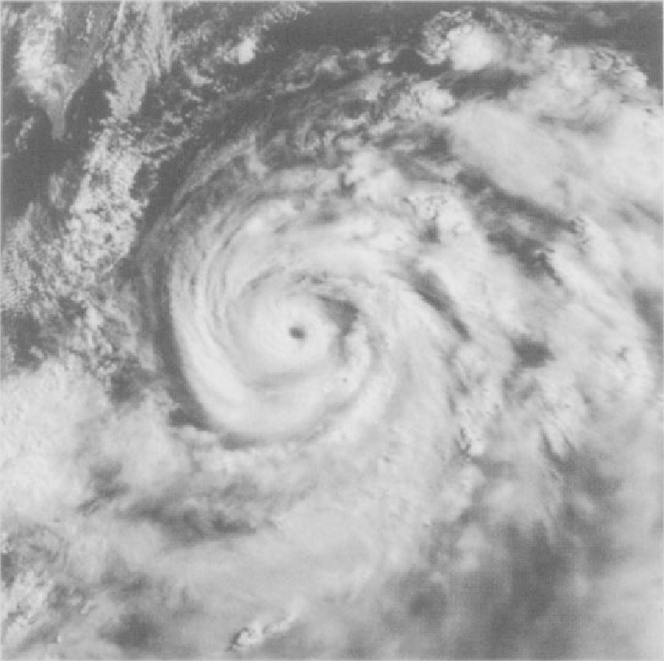
Predicting the weather: fighting the Butterfly Effect
Chaotic behaviour
Fluid dynamics
Turbulence
Extremely computationally expensive + coping with chaos

Slide 3
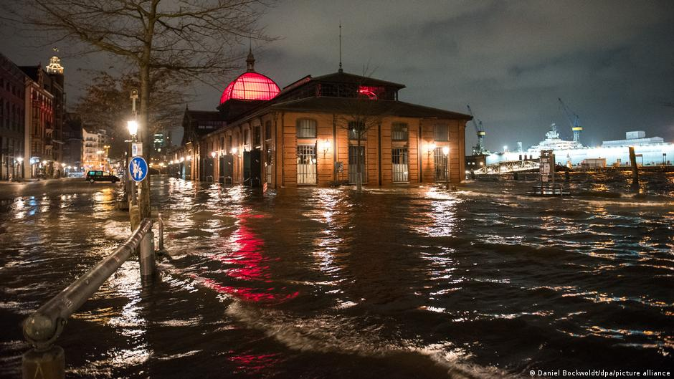
Importance of Nowcasting in the context of more frequent Severe Convective Storms in Europe
Germany, last week, storm causes devastating tornadoes
Significant increase of severe meteo phenomena in Europe in recent years
Can ML models predict SCSs?

Slide 4
Data Model:
Satellite imagery from the EUMESAT Meteosat-11 satellite covering Europe and Africa
Continuous stream of images ( one every 15 minutes)
Meteo product employed: Convection RGB
Focus on Europe

Slide 5
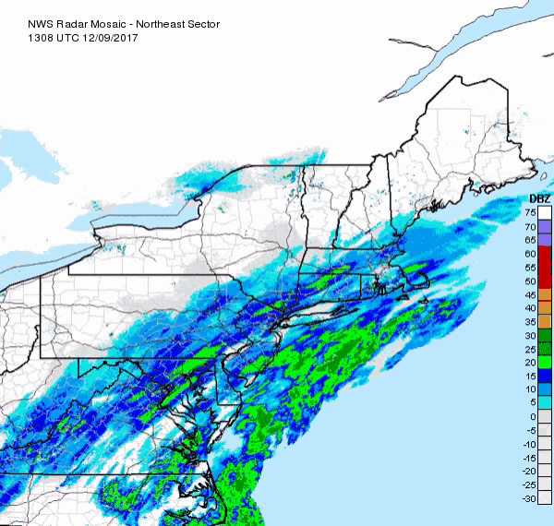
Why ConvLSTM?
Works very well on temporal progressions of data
Models well slightly organized movement in chaotic contexts
Simple and straightforward DL architecture, best fit for a temporal progression of high res imagery

Slide 6
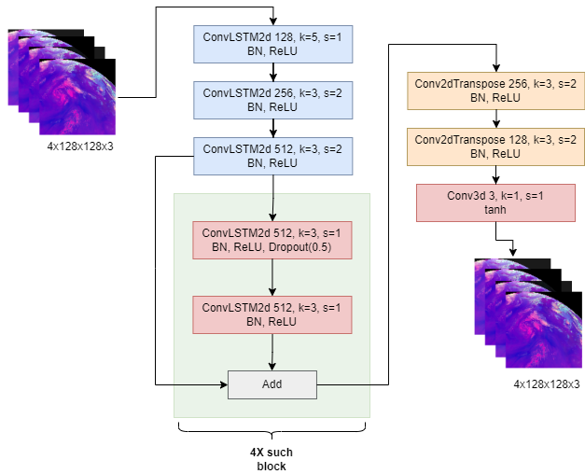
Proposed Architecture

Slide 7
Performance Evaluation
Baseline CNN:
Baseline U-Net:
Baseline Pix2Pi GAN:

Slide 8
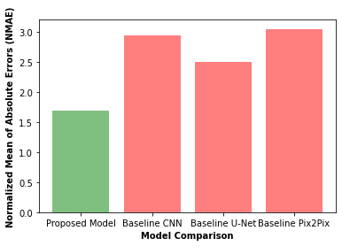

Slide 9
Obtained result on satellite imagery

Slide 10
Conclusions and future improvements
The ConvLSTM model adapts well to the nowcasting based on satellite imagery problem
The obtained performances need to be evaluated not only from a numerical perspective but, more importantly, from a meteorological perspective
Further effort should be employed on adapting the input parameters to more accurate nowcasting needs

